Slide 1
TATA AIG
KT by Sumeet Mitra

Slide 2
LOBS
Travel – Adobe
Health– Adobe
Car (4W) – Adobe
Bike (2W) – Adobe
Auto (3W) – Adobe
Marine – GA4
Group Health – GA4
Fire and burglary – GA4
Marine open policy – GA4
Travel Insurance
Health Insurance
Motor Insurance
SME Insurance

Slide 3
Travel
Health/bike
Car
Ehtesham Shaikh – Marketing Manager
Anjali Krishna – Website Manager
Abirami Iyer – Senior Manager
Rahul Poojari – Marketing manager
Nikhil Karadge – Website manager
Abirami Iyer– Senior Manager
Gaurav Chaudhary – Marketing manager
Gopal Singh/ Janhavi more– Website manager
Allen – Senior Manager
Auto
SME
Motor Renewal
Junaid - Marketing manager
Gopal Singh – website Manager
Kingslee – Marketing Manager
Nirali – Website Manager
Aditya Dawre – Senior Manager
jijo - website manager
Gopal Singh – senior Manager
Non SME developers
SME developers
Rishabh/Sricharangoud– developers
Abhishek – senior developer
Sanskriti – developers
Nandita jain – senior developer

Slide 4
Websites
https://www.tataaig.com/ - Customer – google search
https://alpha10bn.tataaig.com/ - us , testing ( otp – 9999)
https://test10bn.tataaig.com/ - developers
https://dev10bn.tataaig.com/ - starting
C – variable, c1 = c category variable 1 – prop – event based
V – variable, v1 = v category variable 1 – evar – visit
Events – action (button click, page load, etc)

Slide 5
Userid- mobile number
Visited the site on 13/5/24
Visited the site on 23/4/24
Page 1
Page url
Page 2
Page 3
Page 1
1
1
1
1
Hits/occurance -4
Page load
Page load
Page load
Page load
1
1
Visits 2
Visitor 1
1
Evar – retain till visit
Vehicle reg
Vehicle reg
Vehicle reg
prop
Vehicle reg
unspecified
unspecified

Slide 6
Page 1
Page 2
Page3
order
Evar – veh reg
Evar – veh reg
Evar – veh reg
Evar – veh reg
Evar – veh reg – order =1

Slide 7
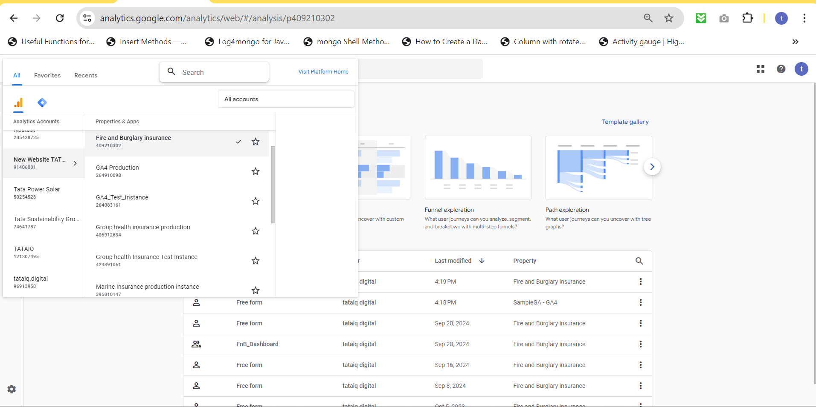
Fire and Burglary Production
All LOBs combined
Group Health Insurance
Marine Insurance / Marine open policy
Use filter as url contains annualopenpolicy

Slide 8
Implementation steps
Digital data and datalayer providing to developers in ppt
Once developers implement it , properly test the datalayers and digitaldata through GTM for all LOBs.
Create the data elements in adobe launch or variables in GTM
Create the names in Report suits in adobe or names in GA4 custom dimensions
Create rules in adobe launch based on events or triggers/Tags in GTM based on events
Publish through library in adobe or publish in GTM the tags
Check the values after 4 hours in adobe analytics or after 1 day in GA4 explore part

Slide 9
Adobe Implimentation

Slide 10
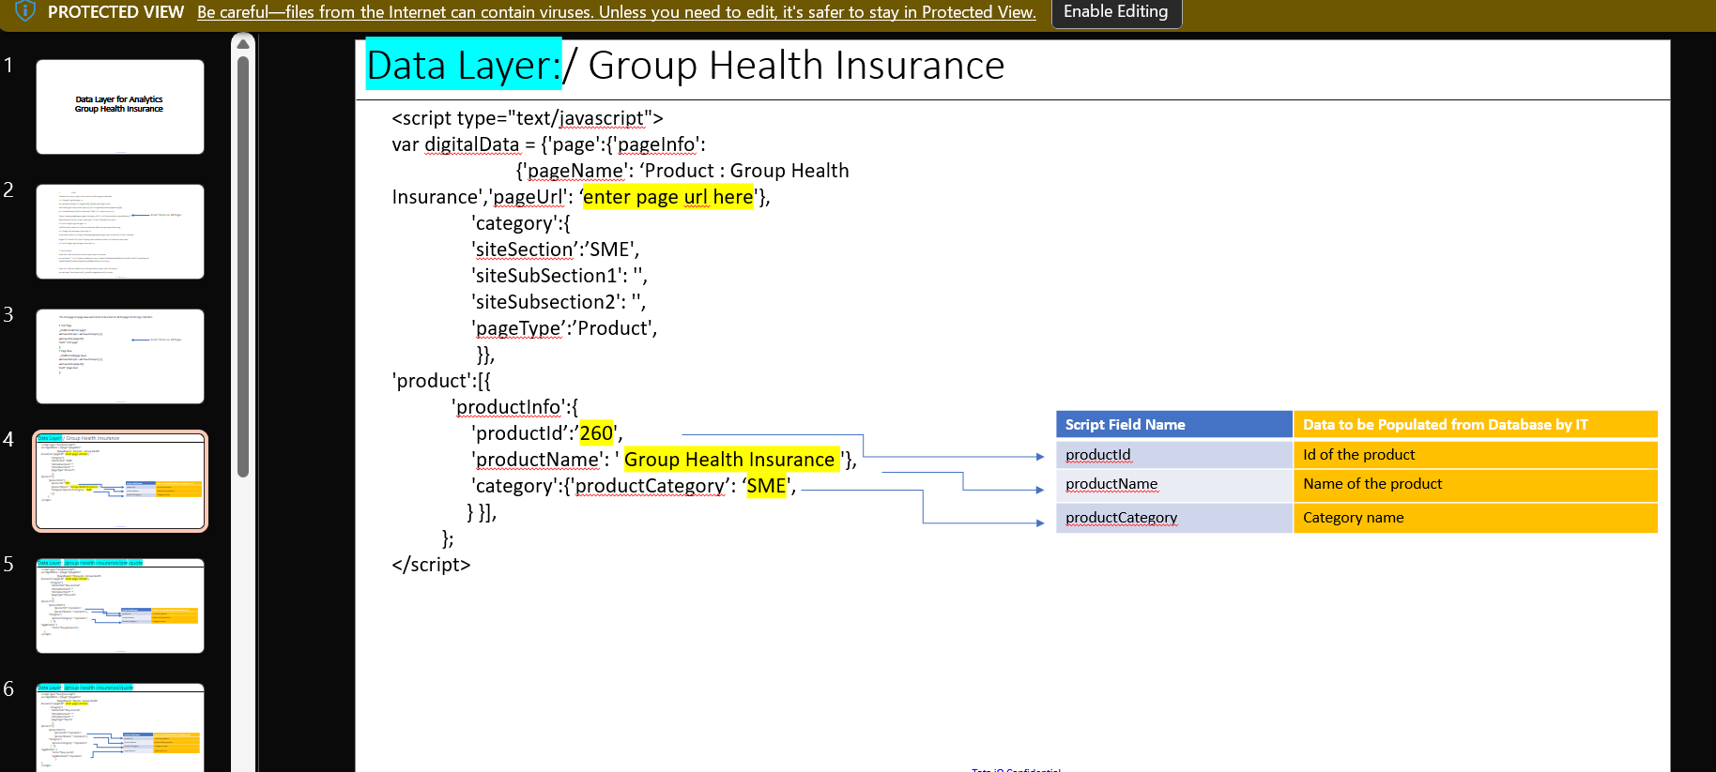
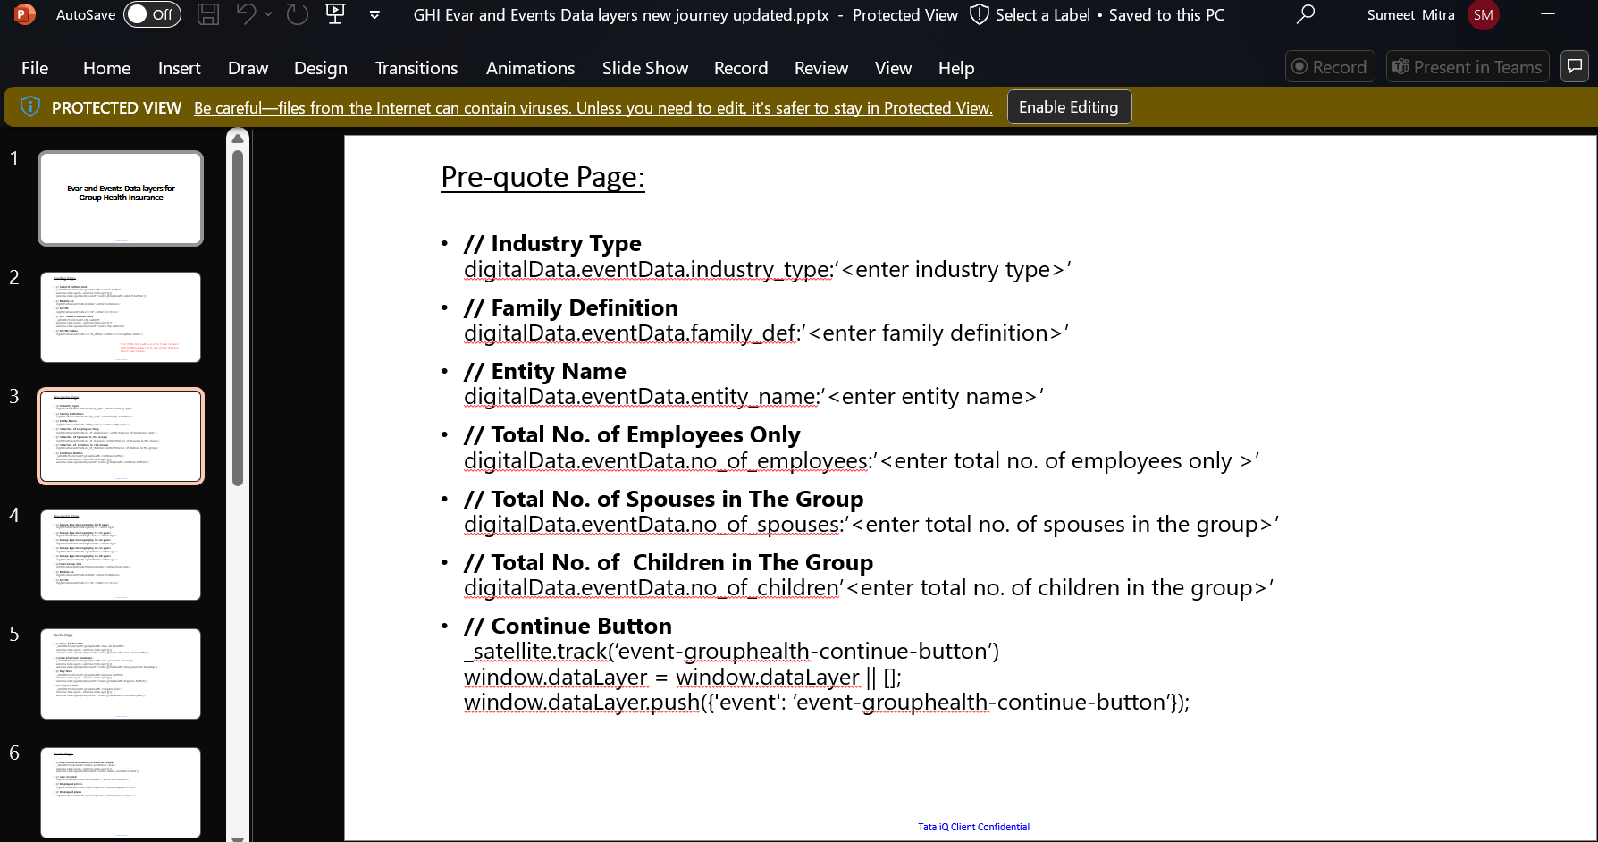
1) Adobe/GA4 datalayer ppt
PPt part 1
Change the product id, product name and product category in ppt.
Check the page name and page type
The new product id should be taken from product master
PPt part 2
The datalayer and digital data that we want to put in our site
It should be page wise

Slide 11
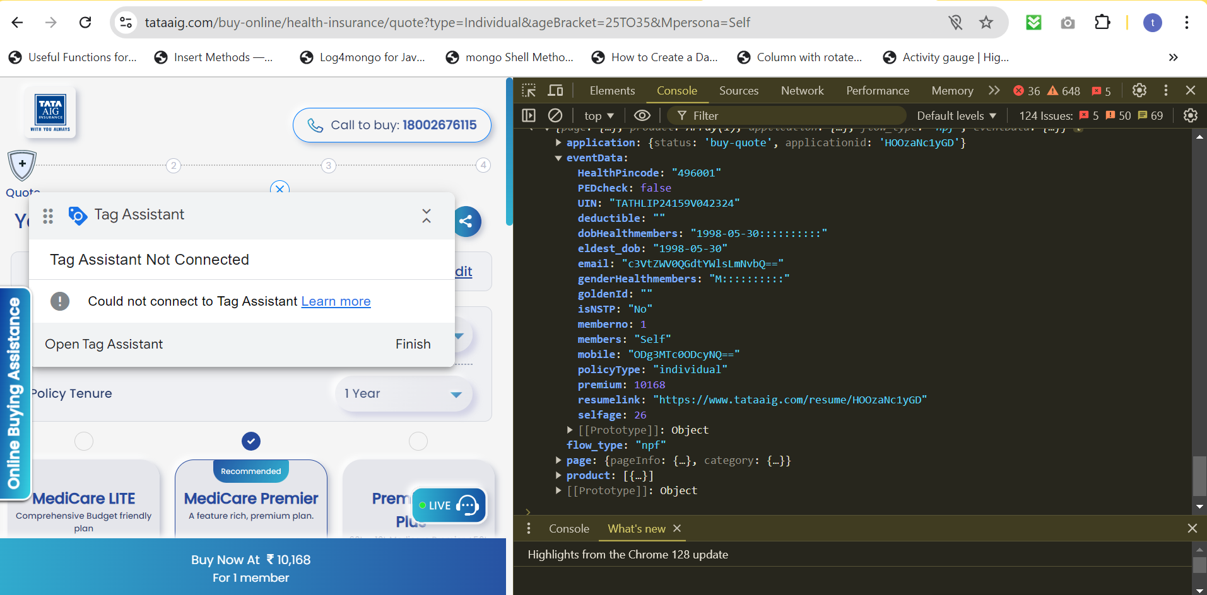
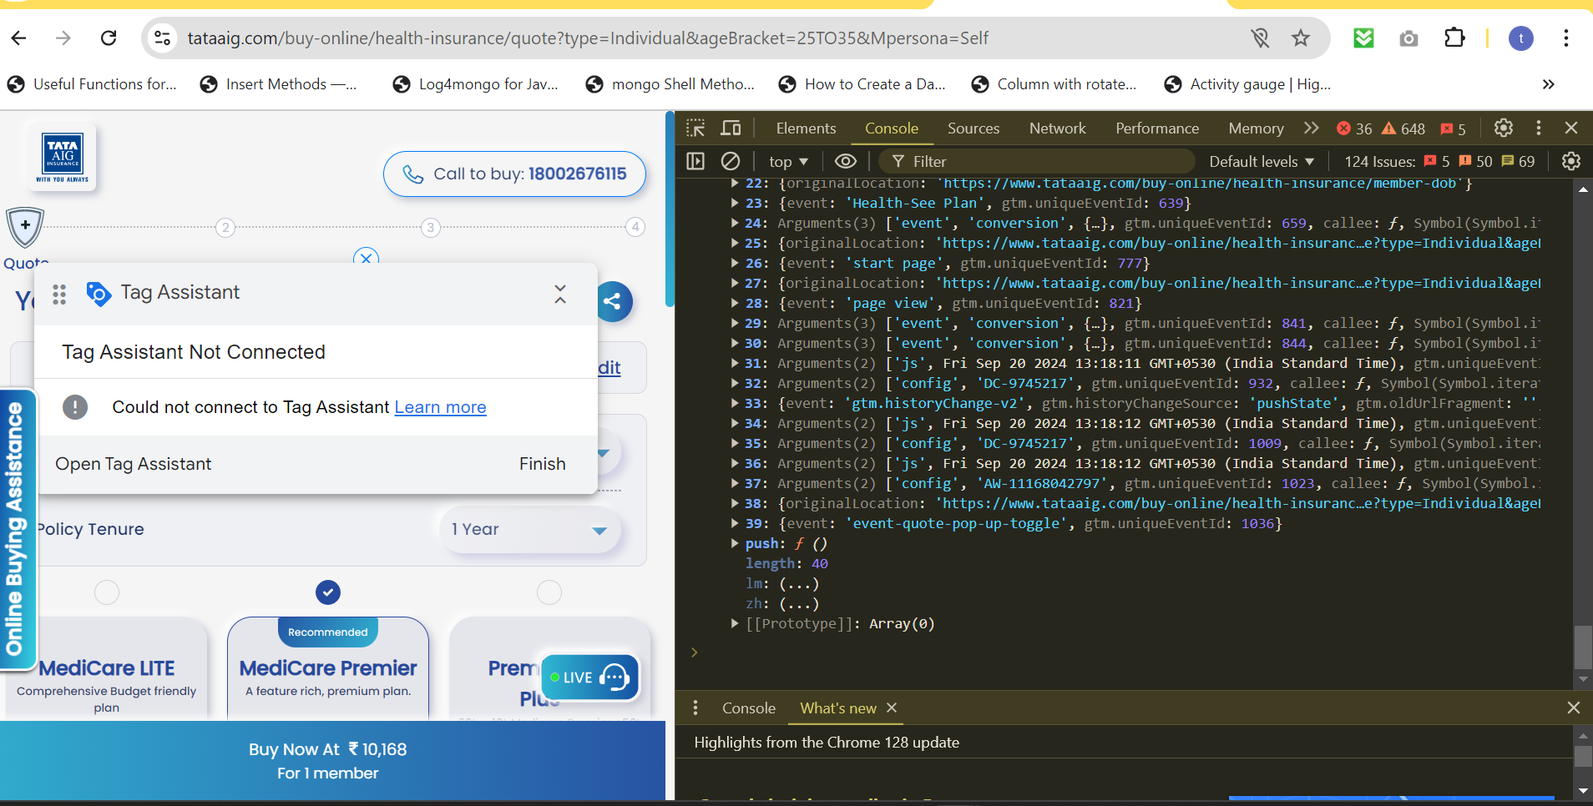
2) Adobe/GA4 datalayer Testing using console
Check the values in eventdata
Use console and type digitaldata for checking
Check the values in datalayer for events
Use console and type datalayers for checking

Slide 12
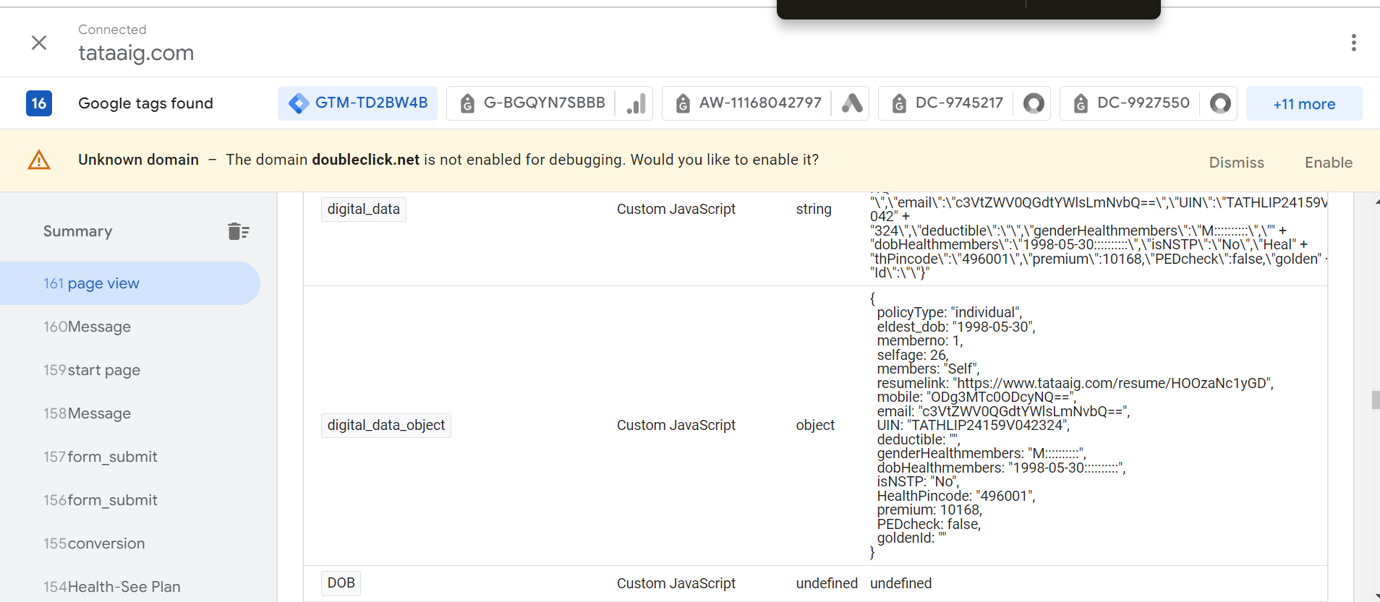
3) Adobe/GA4 datalayer Testing using GTM
Check if the values in digital_data_object are correctly captured during page view or any other event firing. In case they are not captured, tell developer that there is timing issue or connect with manager.

Slide 13
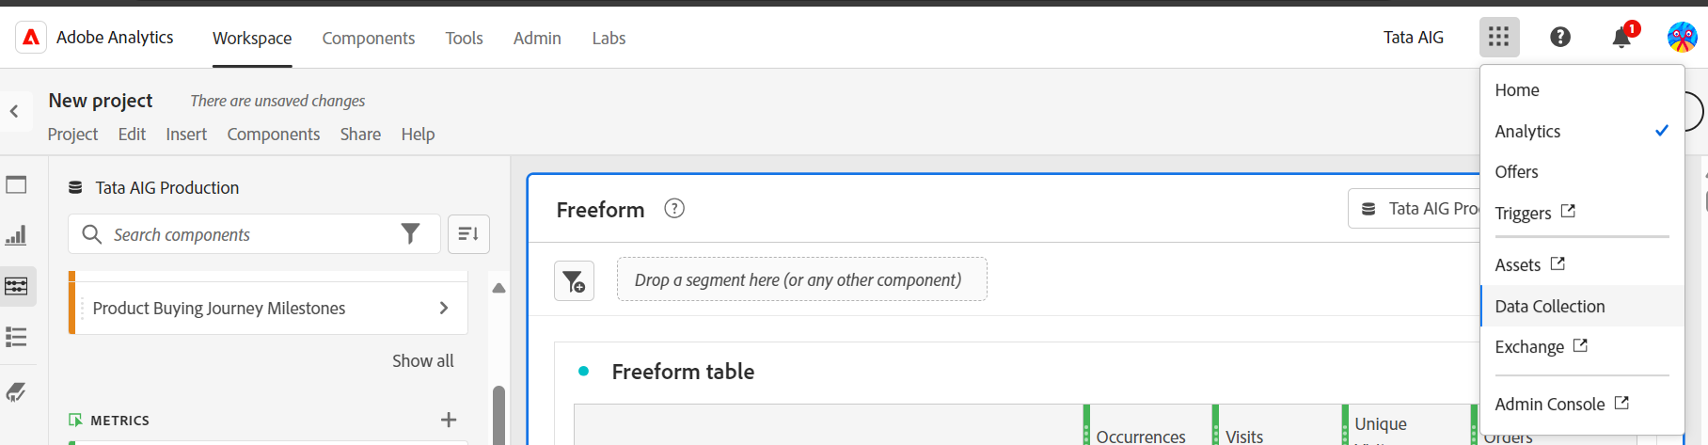
4) Adobe launch tab click (data collection)

Slide 14
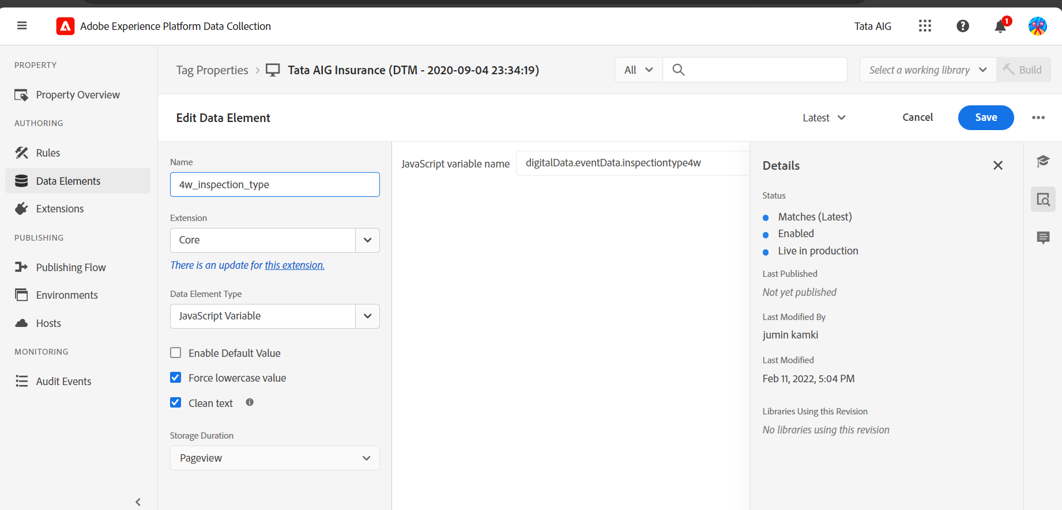
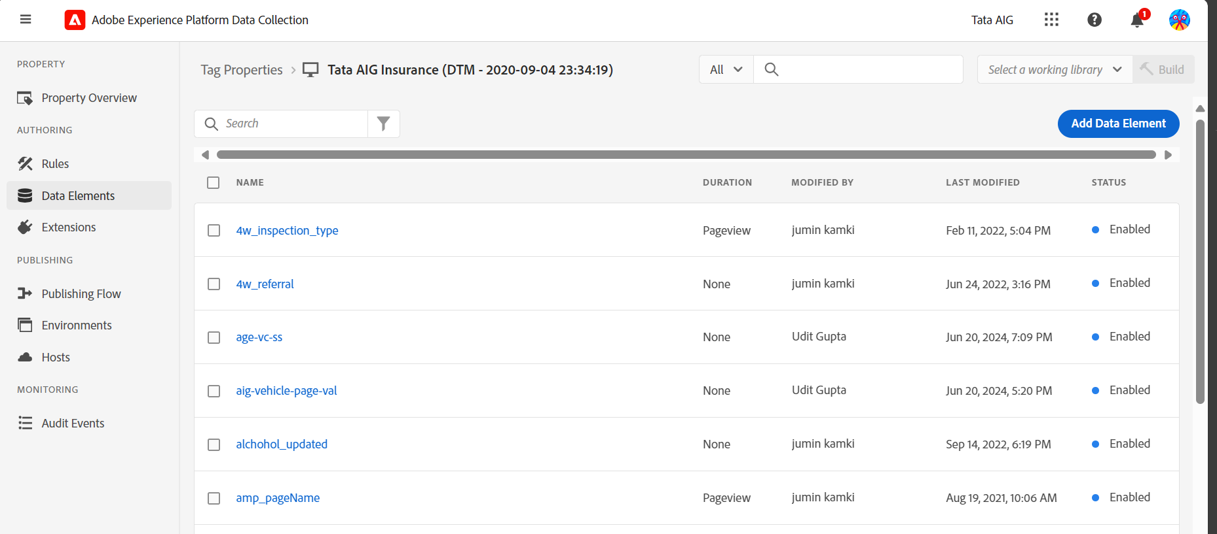
5) Adobe data elements create
Add the digitaldata from ppt into this field and create all the variables
Remember this name to be used in future steps

Slide 15
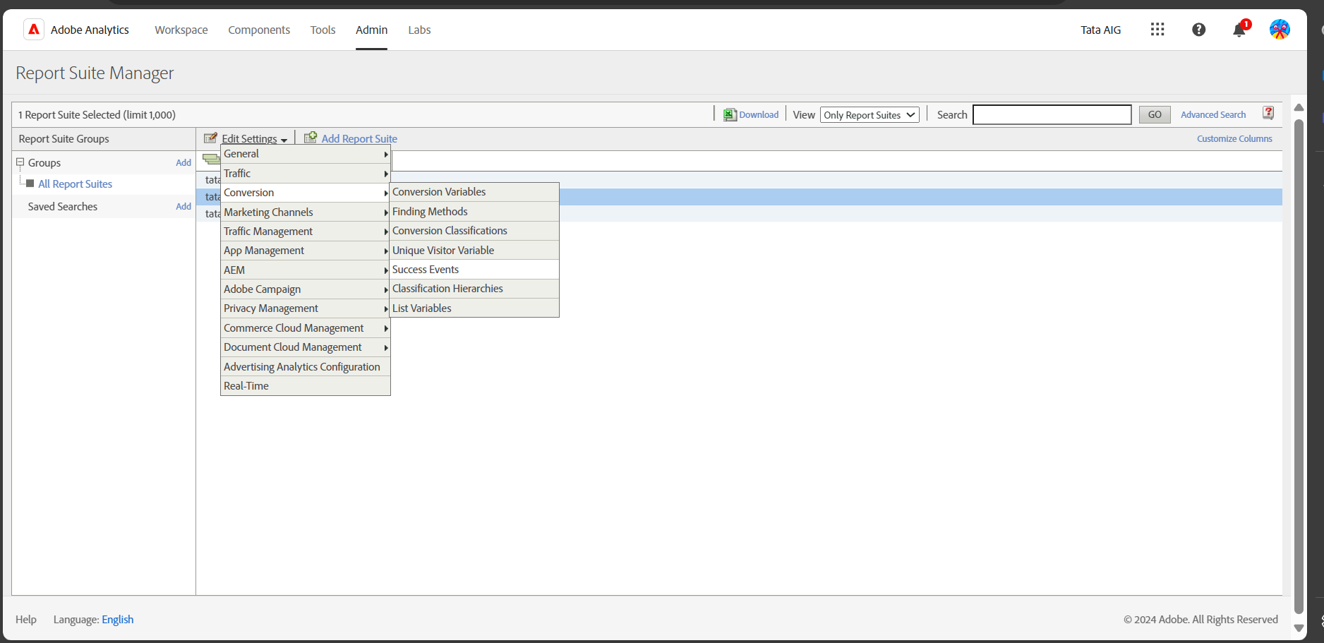
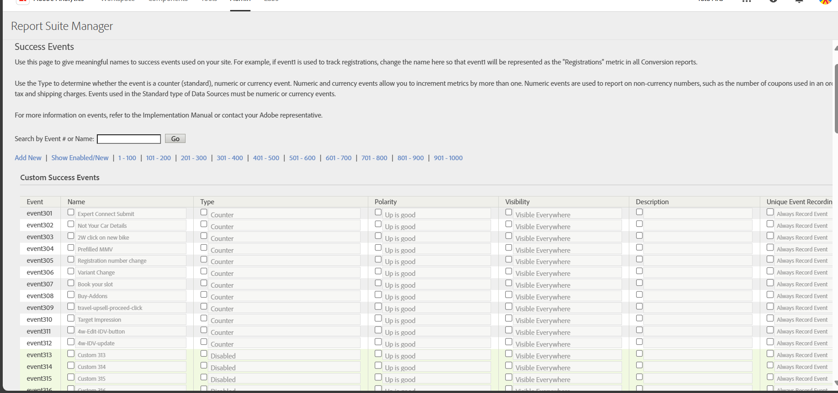
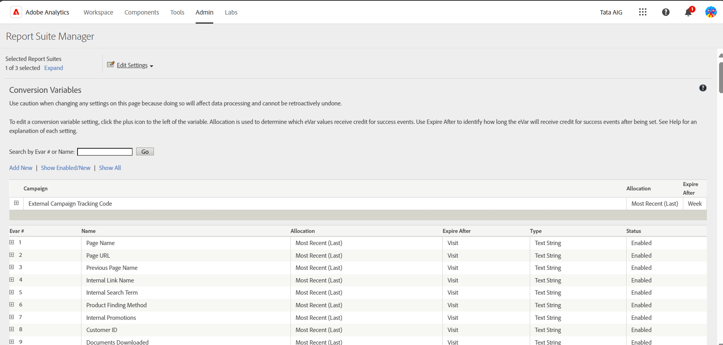
6) Create names in report suits in admin section
Admin -> report suits -> TATA Aig production ->edit settings conversion -> success events (for events)
Conversion variable (for evars) or Traffic -> Traffic variables( for props)

Slide 16
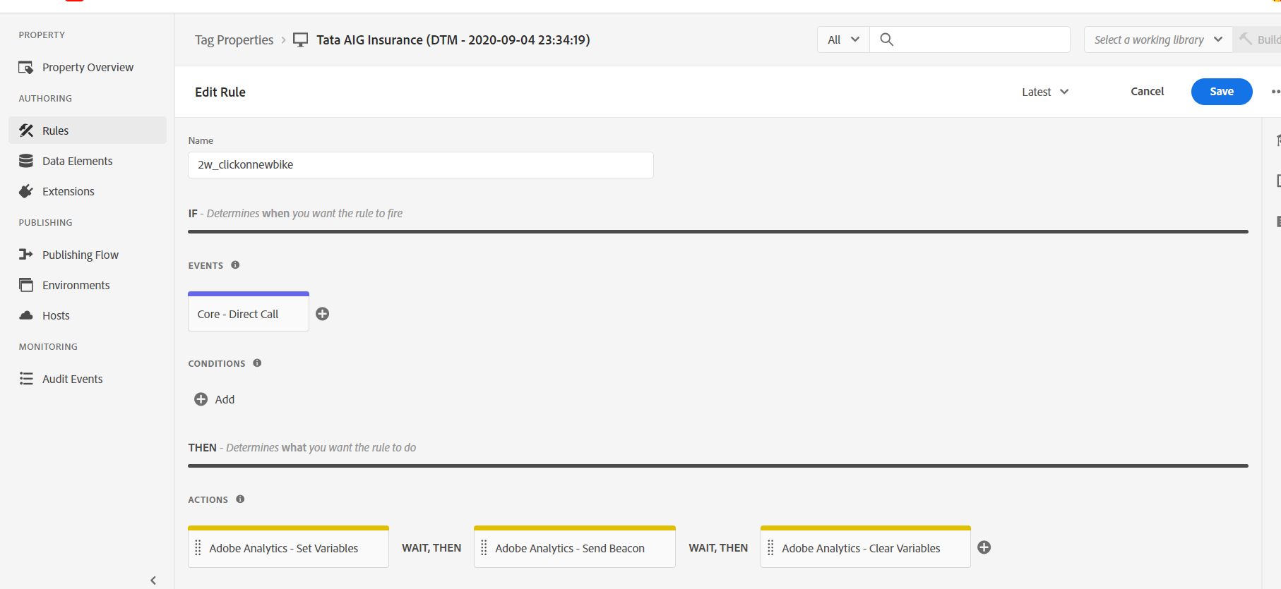
6.a) Adobe Rules Create Through custom events
Use any name here
Duplicate/copy the already made tags
Changes to be done only in direct call and set variables

Slide 17
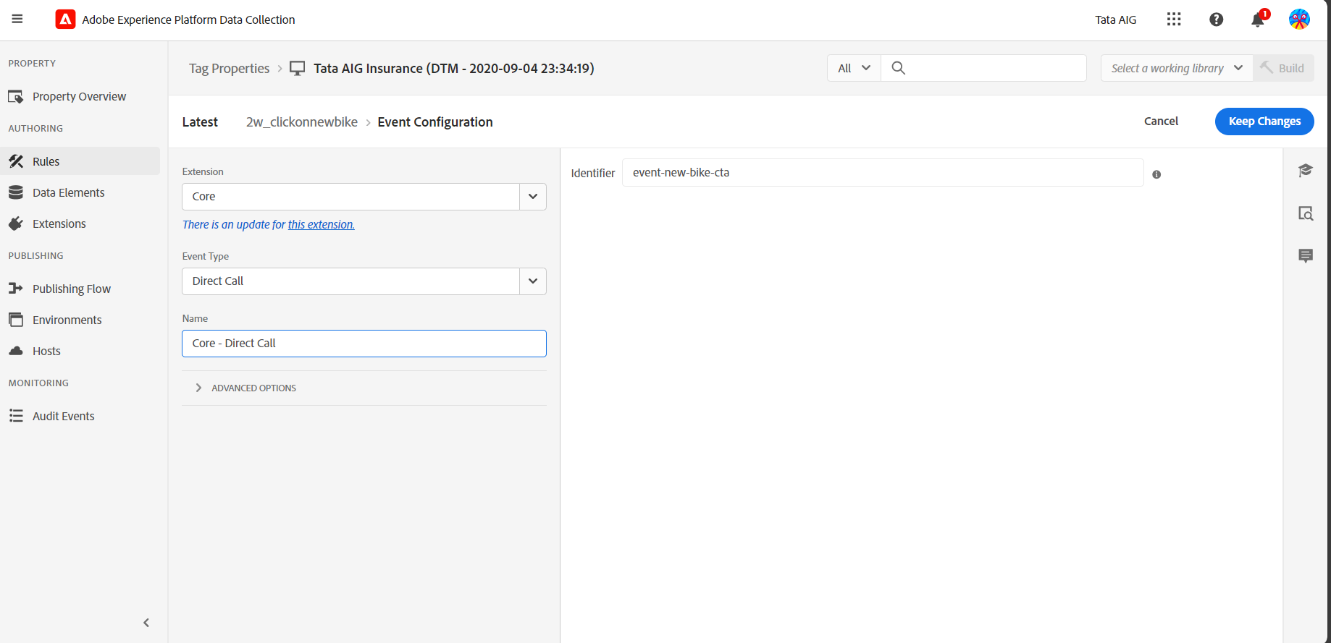
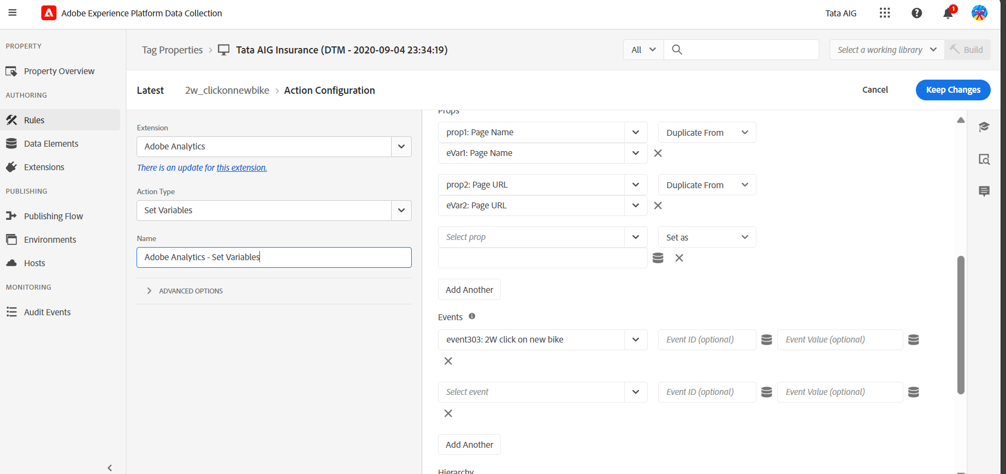
Set variables
Direct Call
Use the name from events name in ppt
Use the event name from report suits names been set before
Page name and page url Props and Evars are remain same as any other tags
New evar created is also added from here
_satellite.track(‘event-new-bike-cta’) window.dataLayer = window.dataLayer || []; window.dataLayer.push({'event': ‘event-new-bike-cta’});

Slide 18
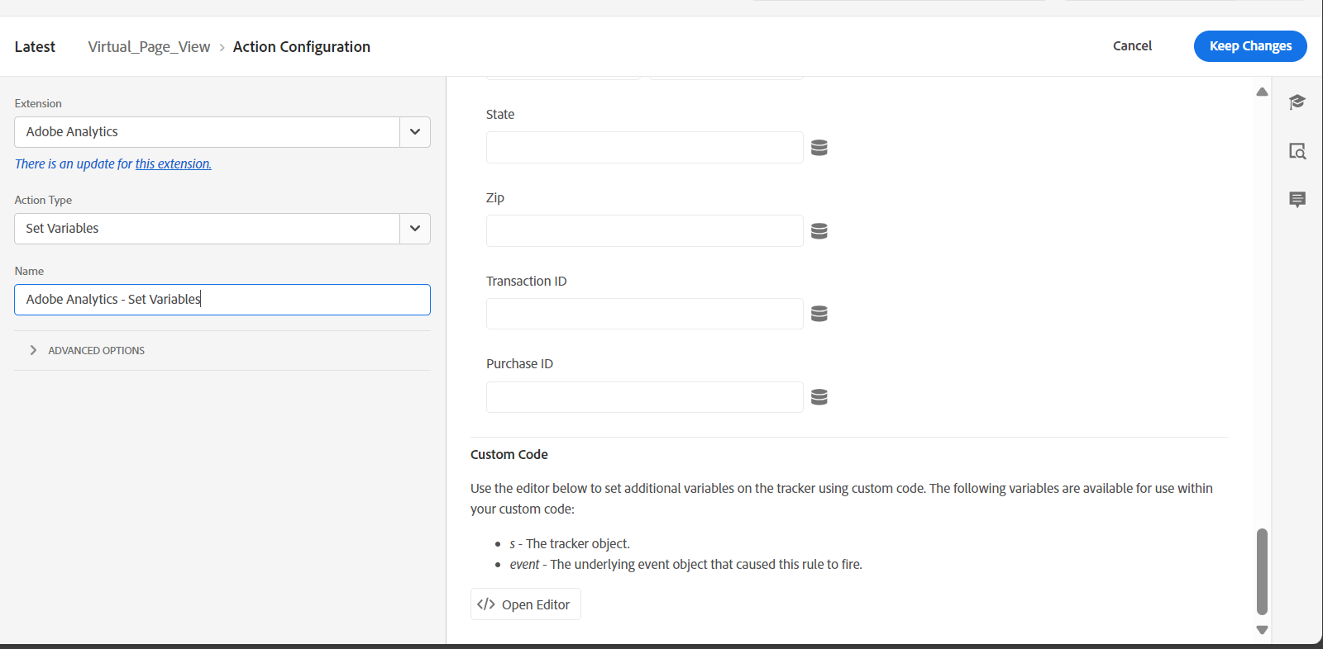
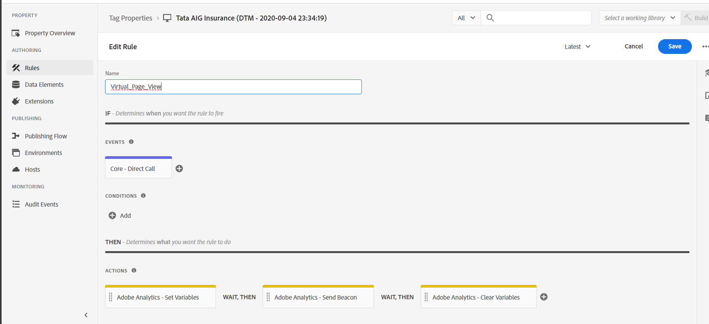
6.b) Adobe Rules Create Through Virtual page view (used only when evar to be fired with page view events)
Edit the set variable part of virtual page view

Slide 19
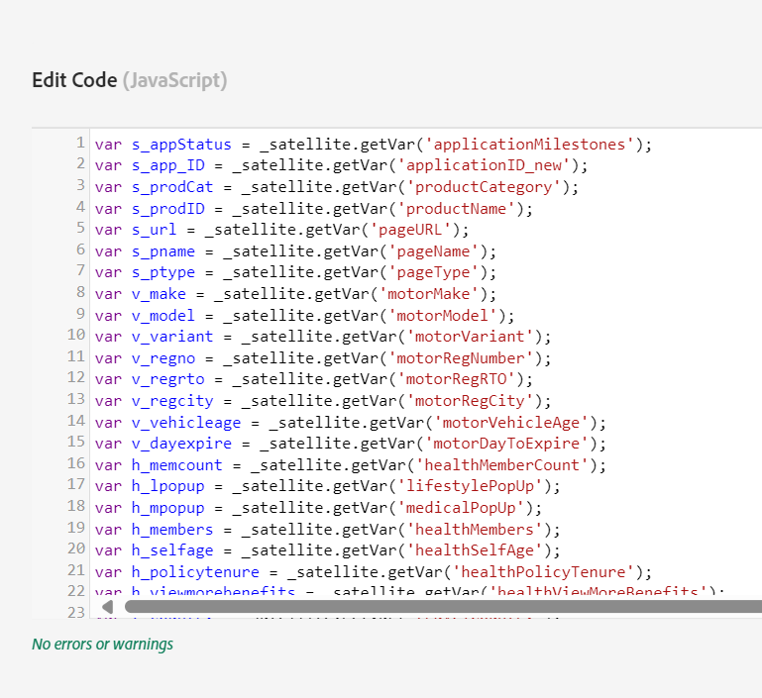
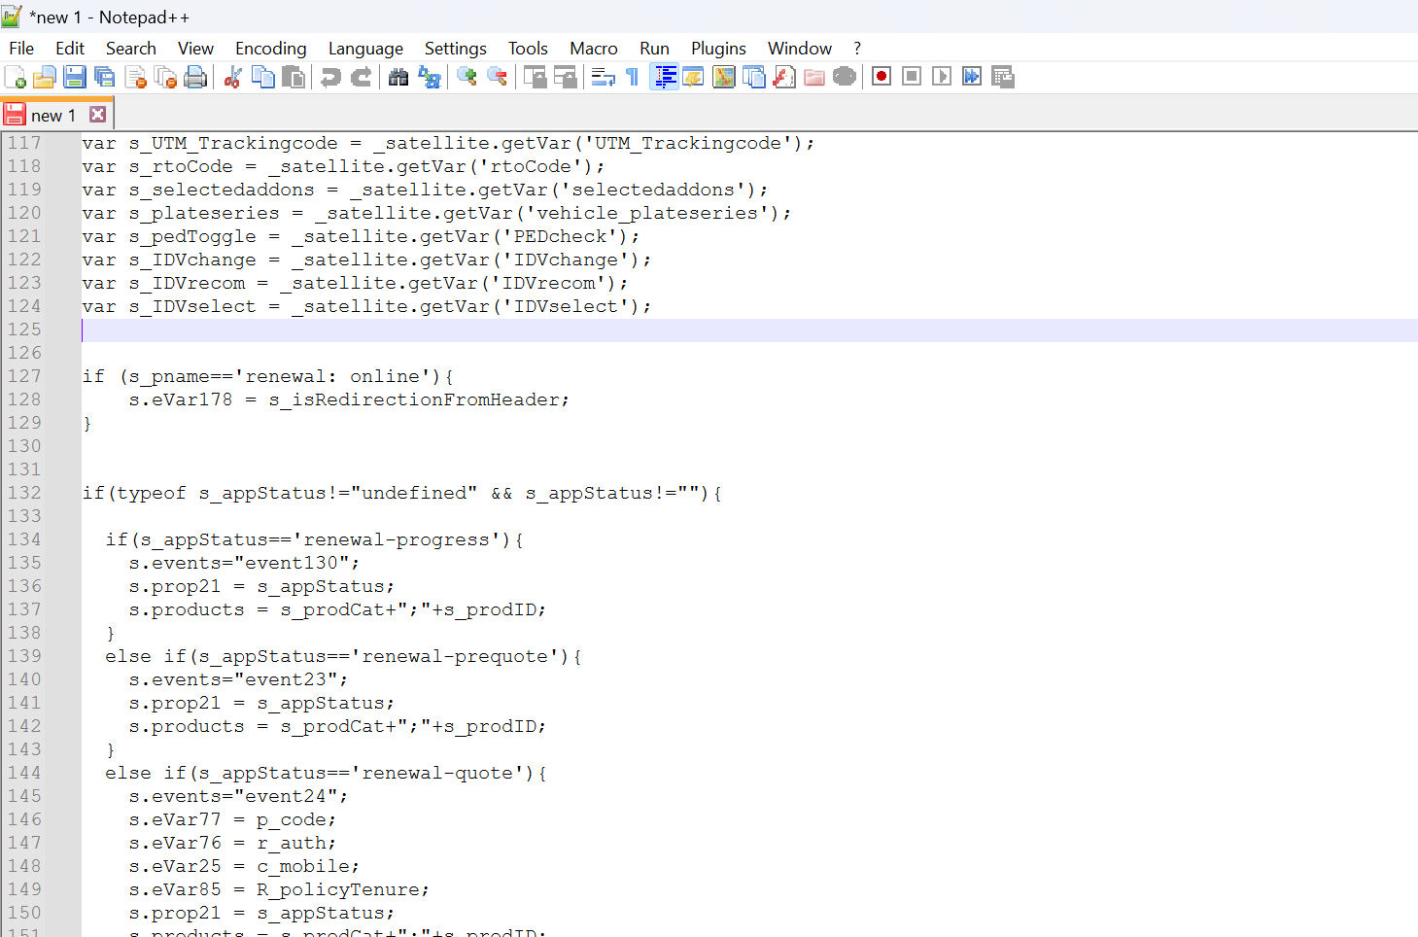
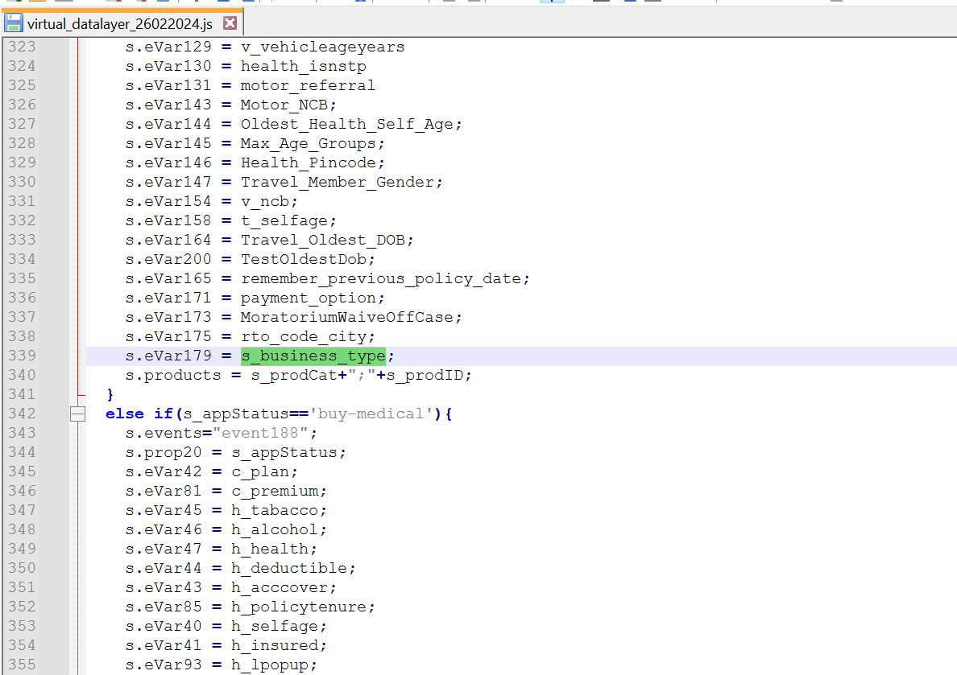
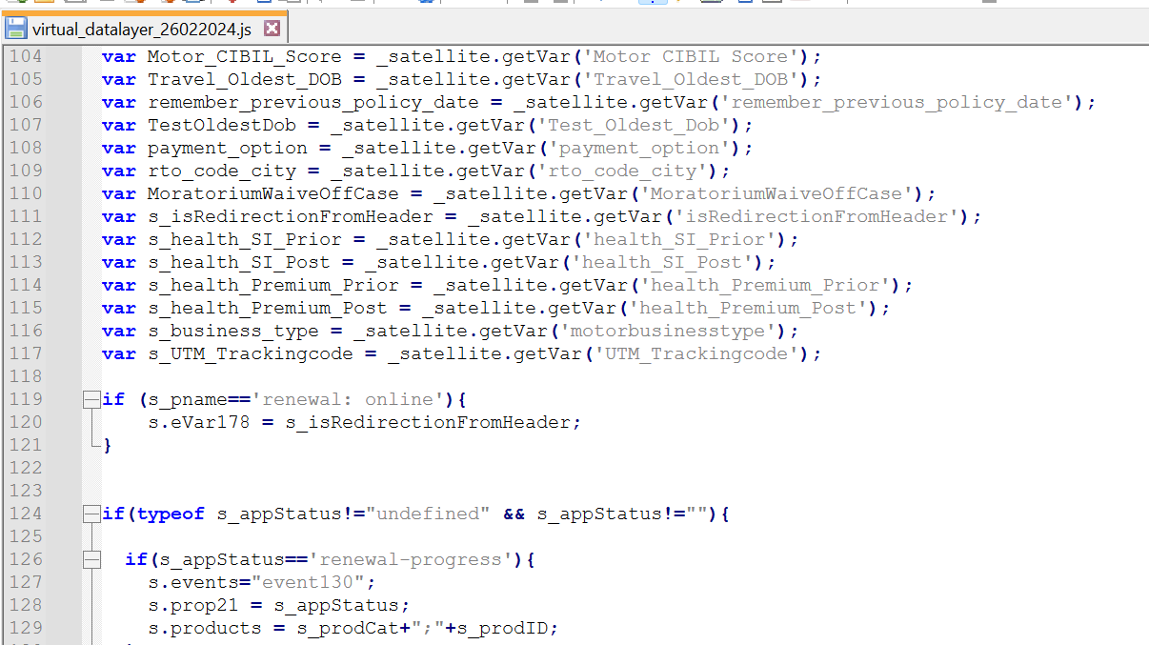
Note: After changes to this code , always have it checked by manager
Open editor
Notepad ++
Create variable
Use variable under which application status , it needs to be added

Slide 20
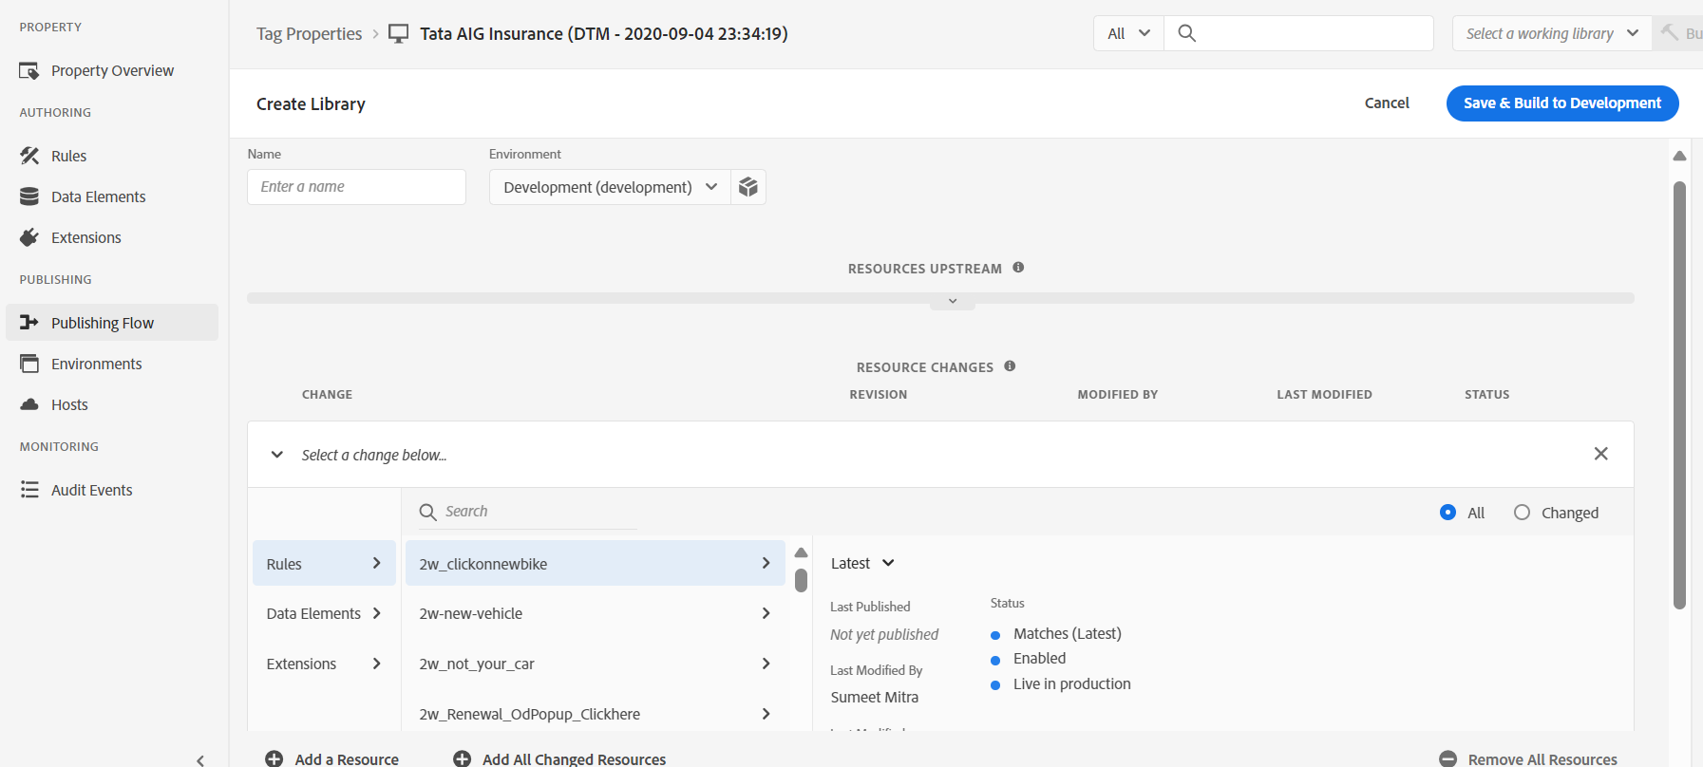
7) Publish the changes
Publishing flow -> add library -> change env to development -> set rules/data elemts as latest -> save and publish to dev

Slide 21
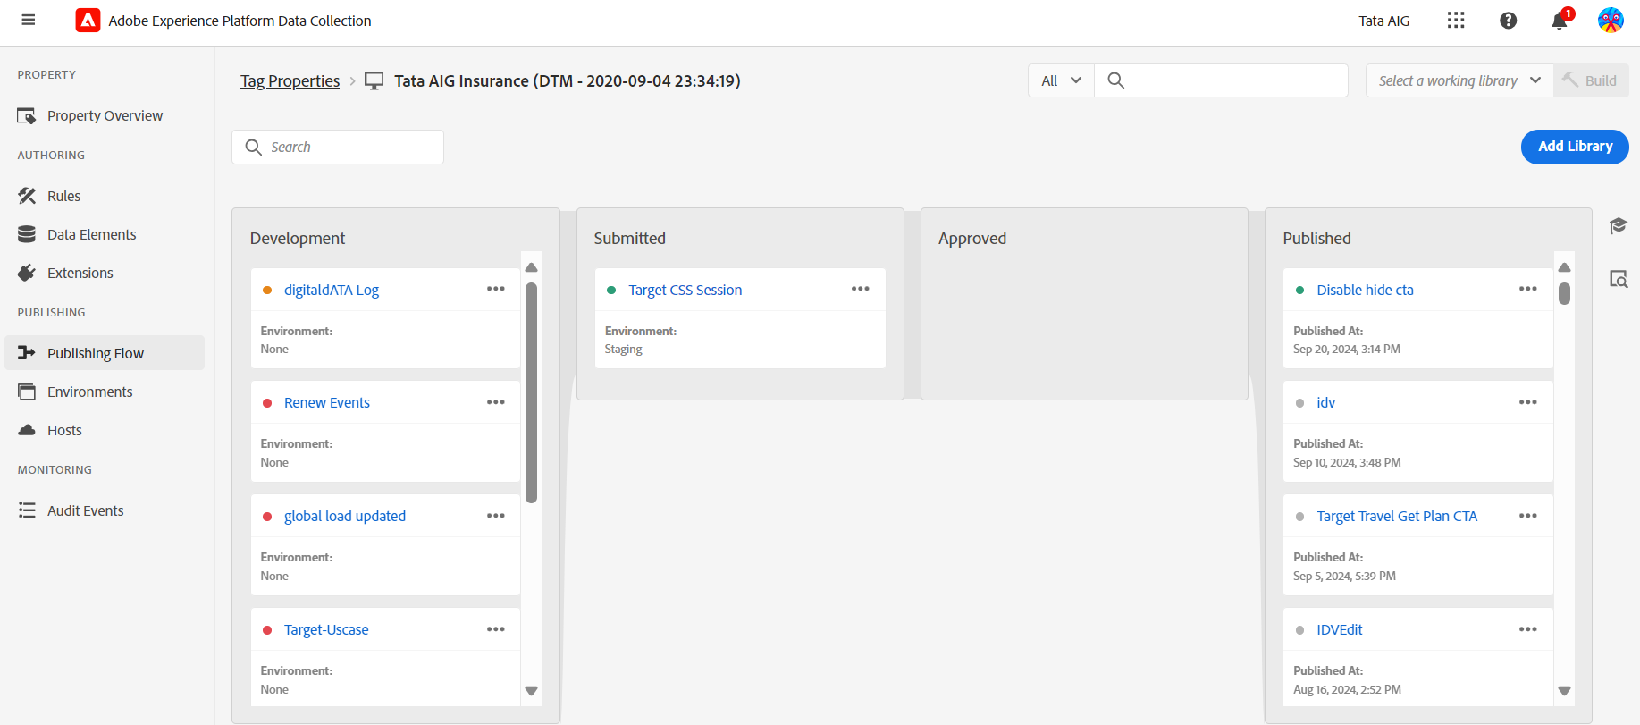
Publish to staging first (for alpha env) -> the if works fine -> publish to prod

Slide 22
GA4 Implimentation

Slide 23
1) Adobe/GA4 datalayer ppt
PPt part 1
Change the product id, product name and product category in ppt.
Check the page name and page type
The new product id should be taken from product master
PPt part 2
The datalayer and digital data that we want to put in our site
It should be page wise

Slide 24
2) Adobe/GA4 datalayer Testing using console
Check the values in eventdata
Use console and type digitaldata for checking
Check the values in datalayer for events
Use console and type datalayers for checking

Slide 25
3) Adobe/GA4 datalayer Testing using GTM
Check if the values in digital_data_object are correctly captured during page view or any other event firing. In case they are not captured, tell developer that there is timing issue or connect with manager.

Slide 26
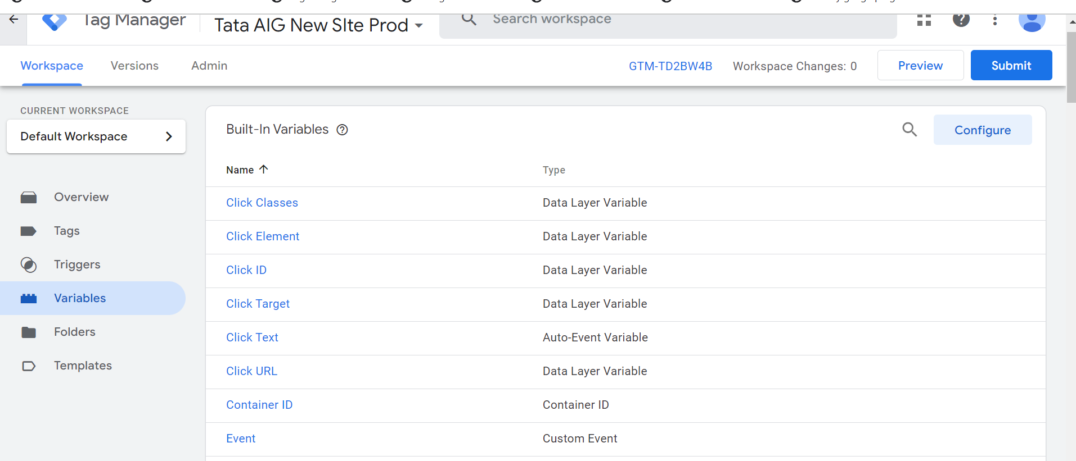
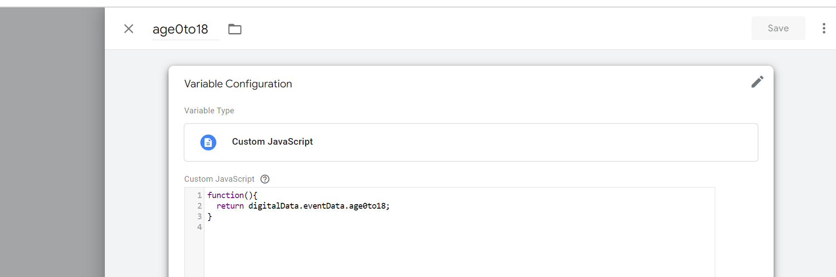
4) Creating variable using GTM

Slide 27
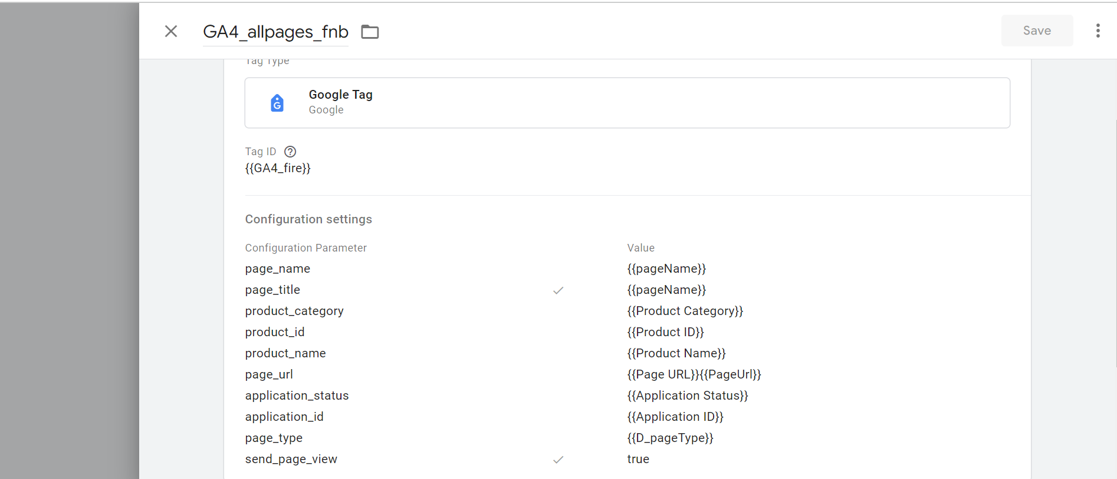
5) Create Global tags only when new LOB is formed

Slide 28
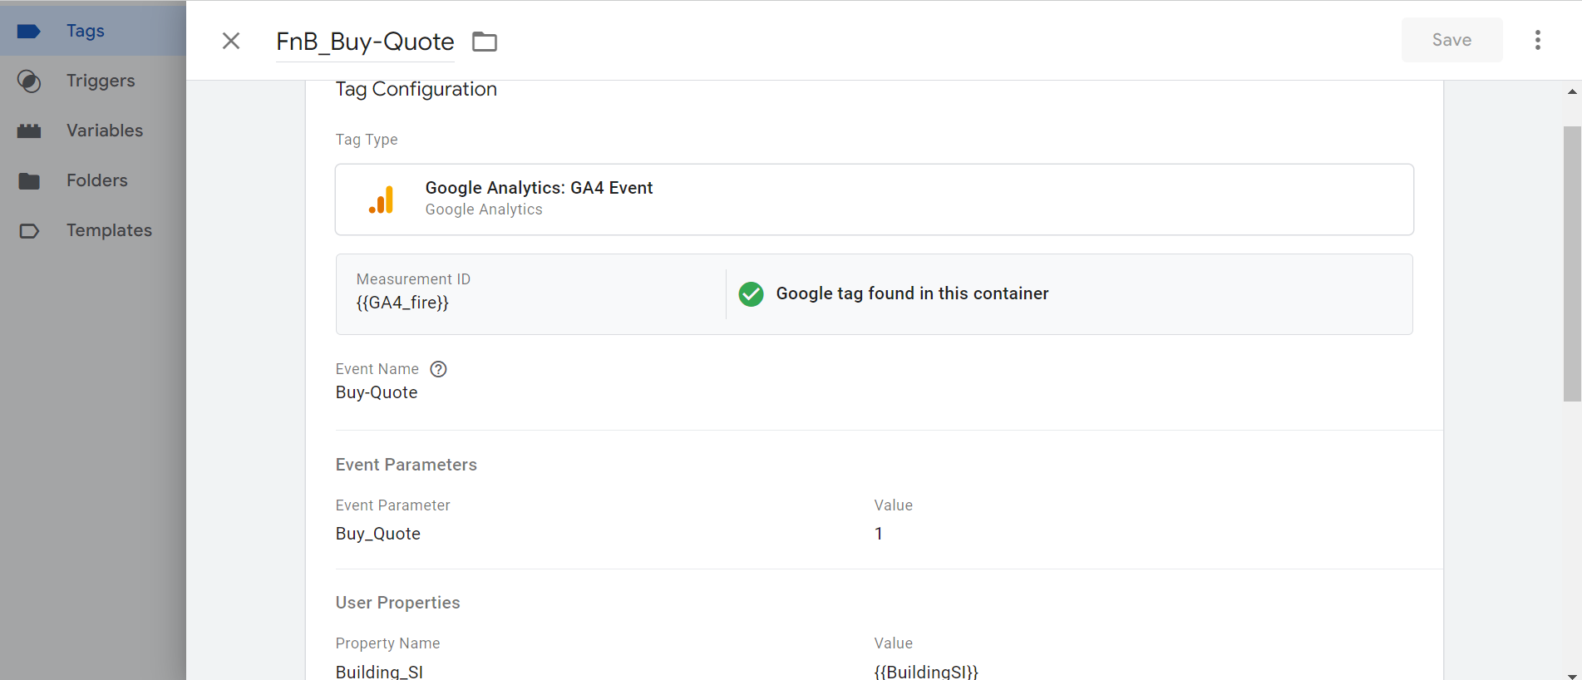
6) Create event Tags
The Event name you want to see as Event list
The variable you want to use for custom metric at GA4
The variables you want to capture as custom dimensions (user based or event based)

Slide 29
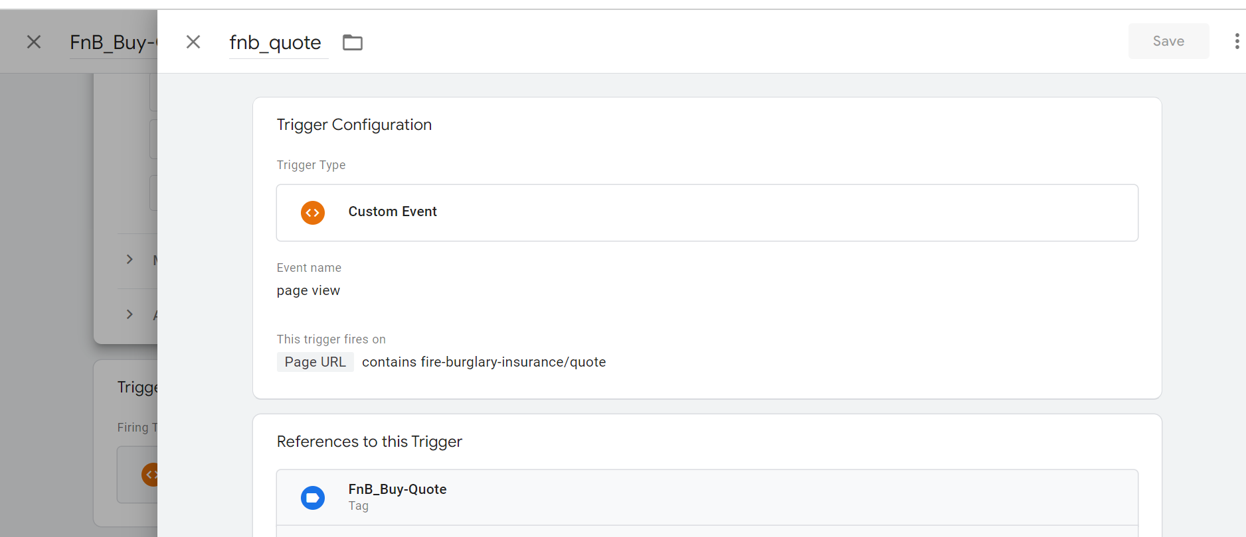
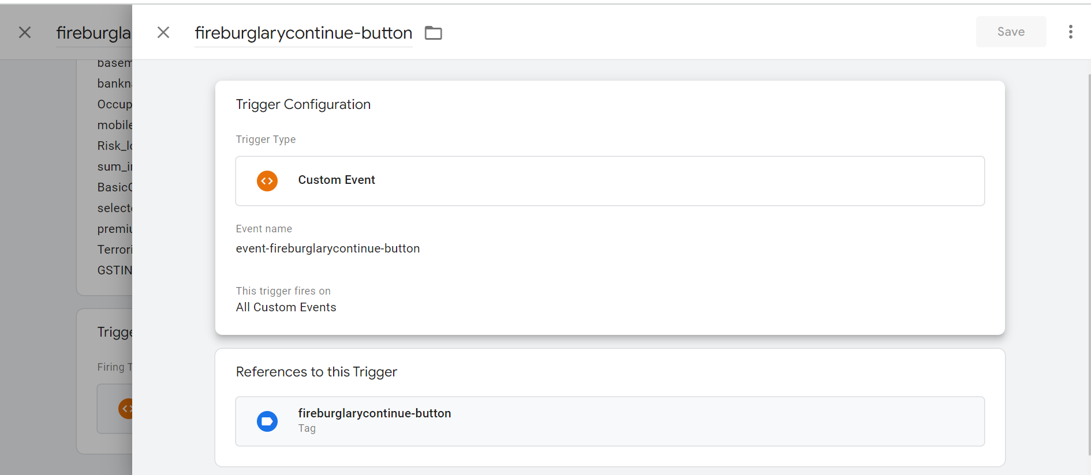
7) Create Trigger in the same event
The event name should be taken from ppt
The event is used along with page url
If event name is page view the specify the page url
Otherwise directly use the event name
OR
_satellite.track(‘event-fireburglarycontinue-button’) window.dataLayer = window.dataLayer || []; window.dataLayer.push({'event': ‘event-fireburglarycontinue-button’});

Slide 30
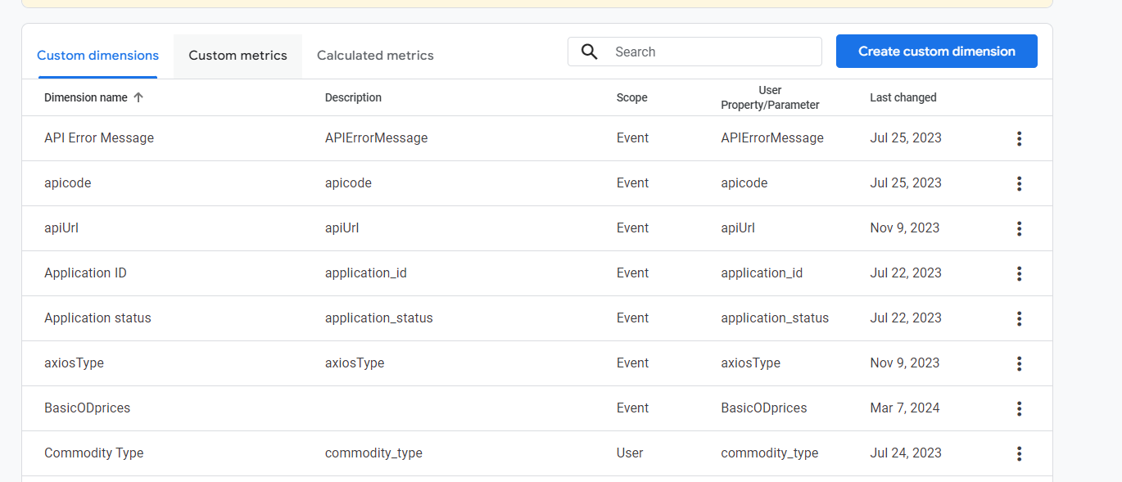
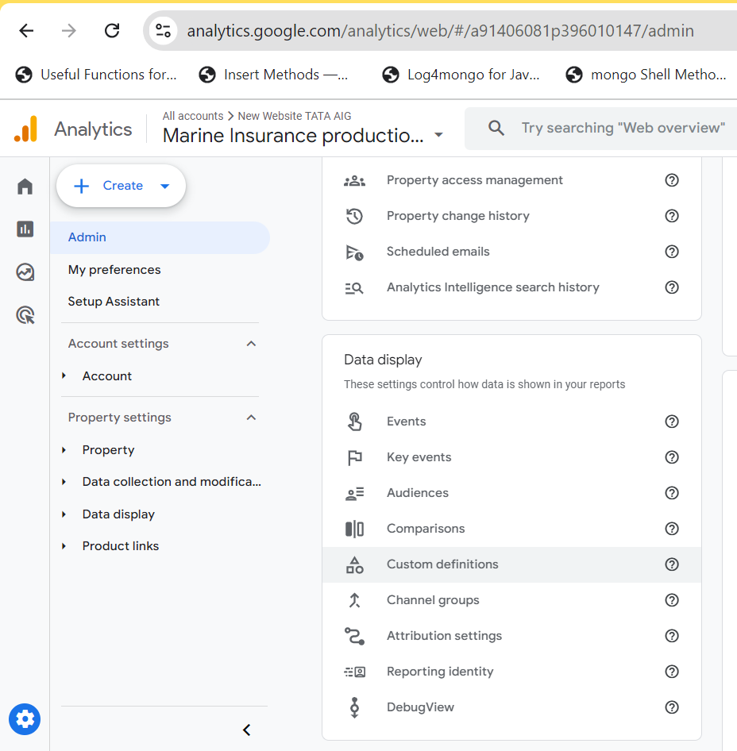
8) Create the custom dimension and metics in GA4
Set the user parameter name same as GTM variable name

Slide 31

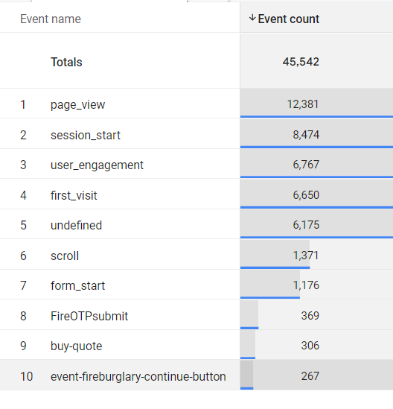
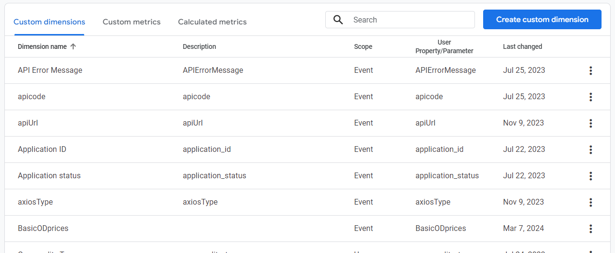
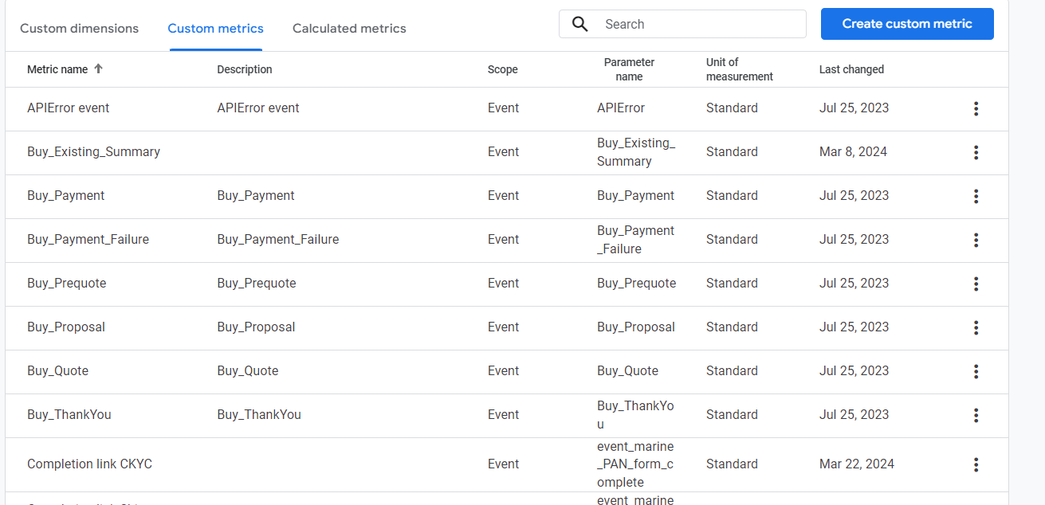
Use scope as User if you are using user property while event if event parameter is used

Slide 32
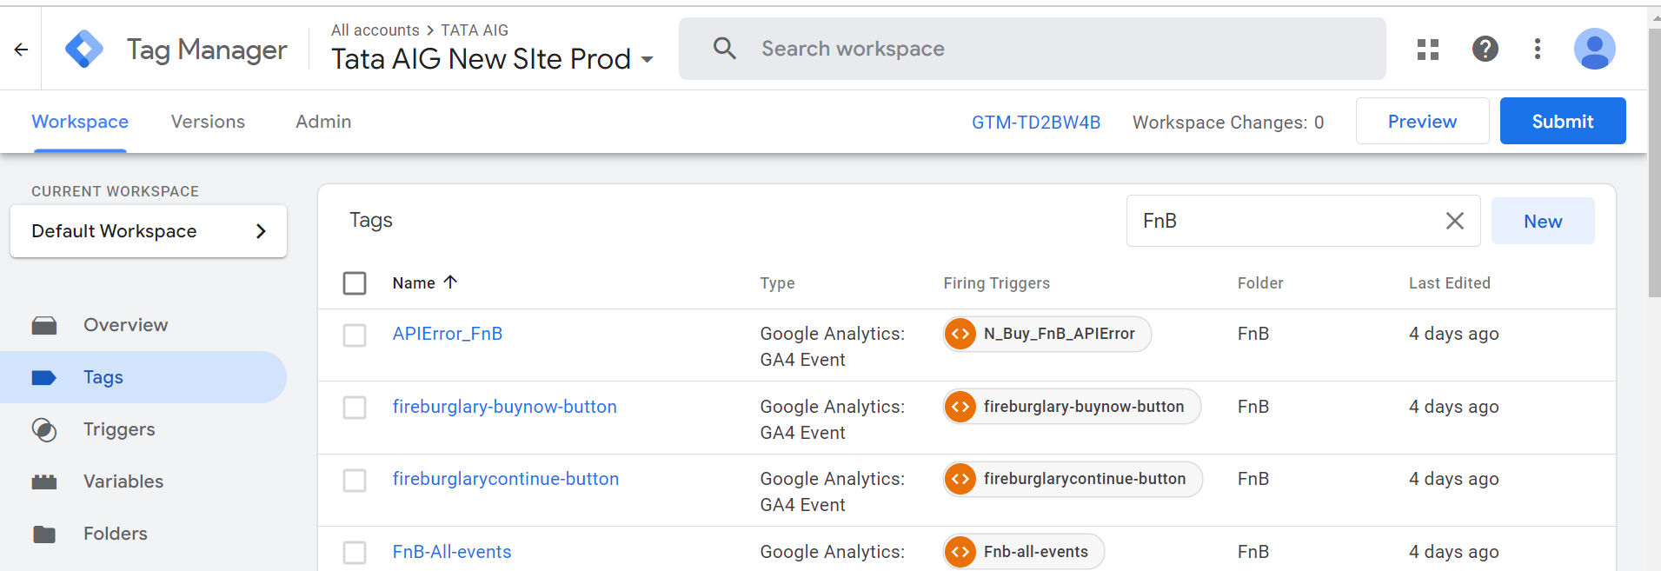
9) Preview and then Publish the GTM container

Slide 33
GTM Pixel Placement

Slide 34
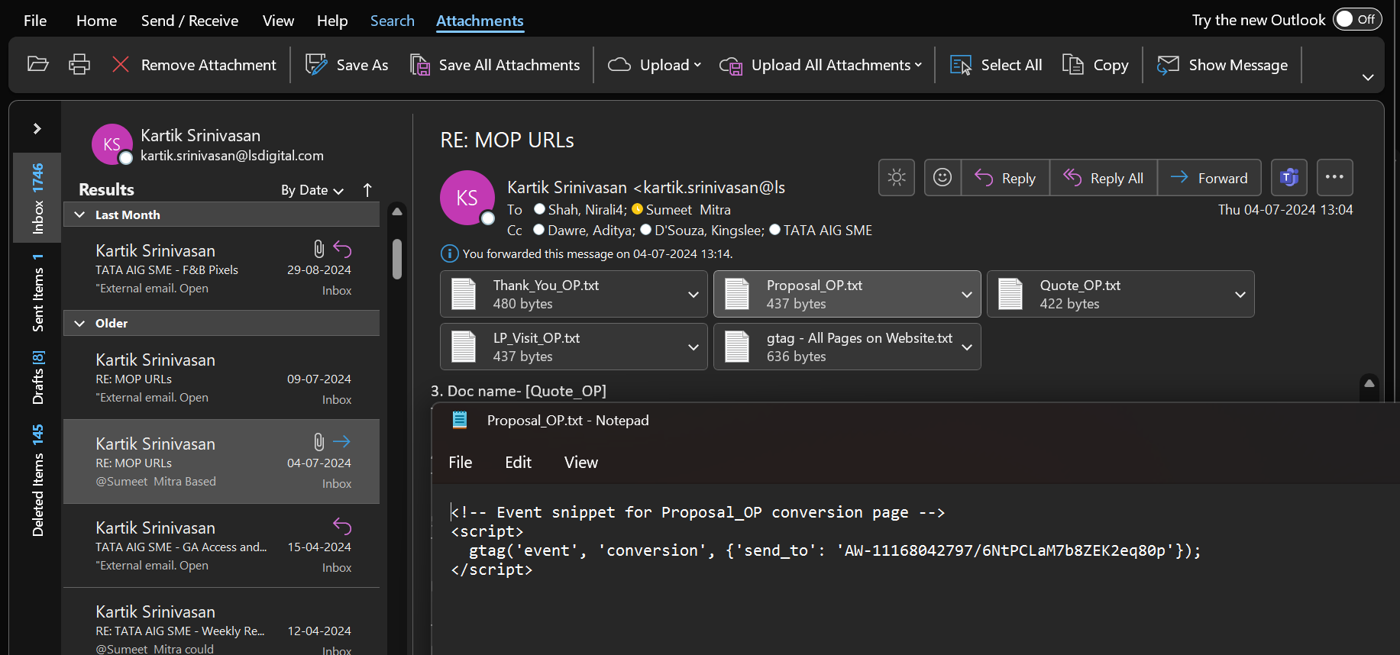
1) Get the google ads mail from marketing agency

Slide 35
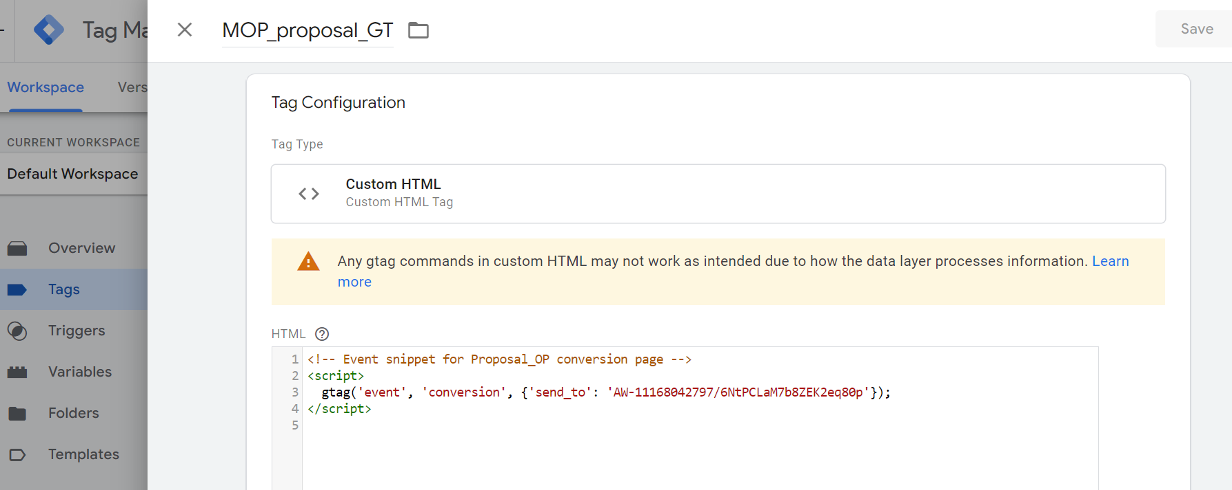
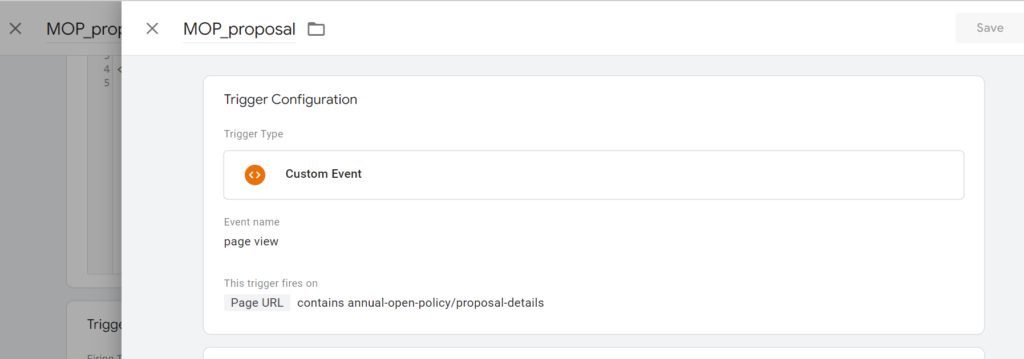
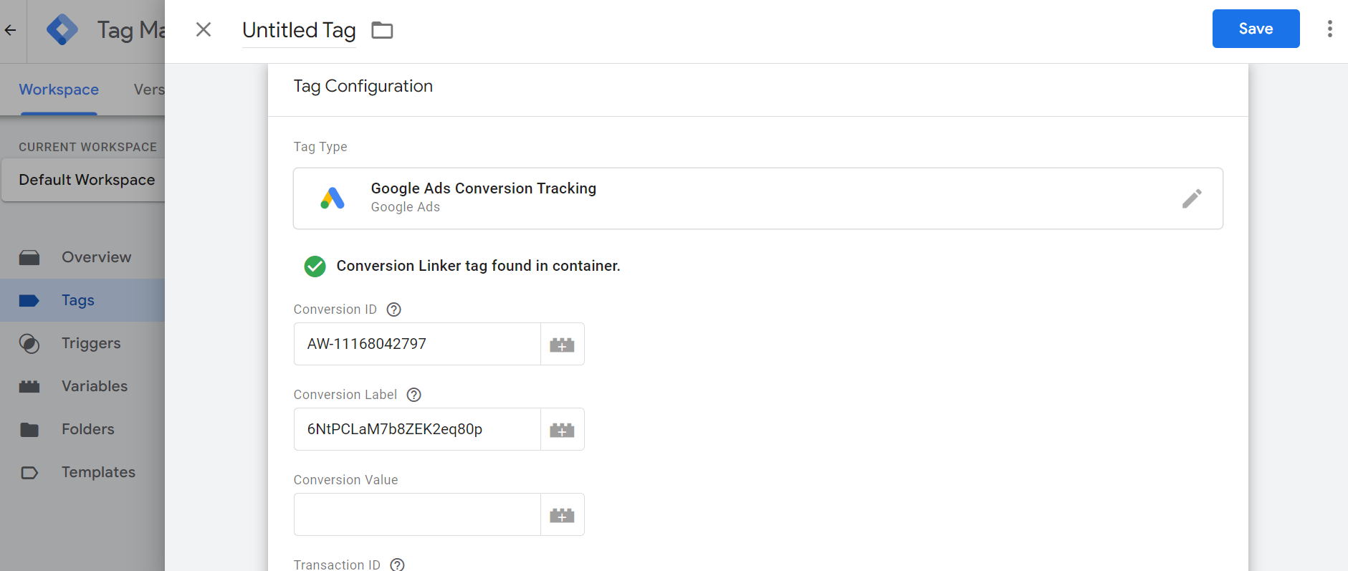
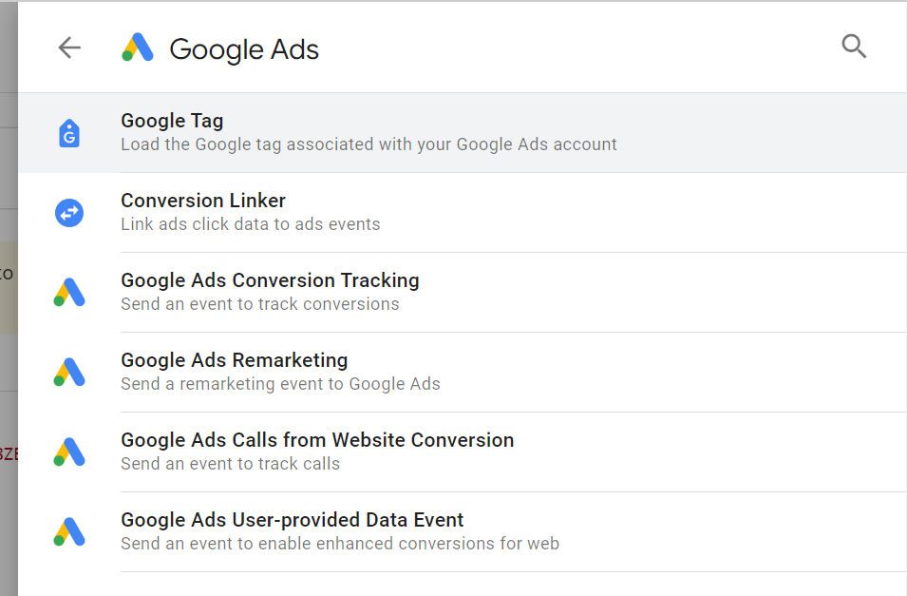
2) Set the tags and triggers in GTM
Tag created by custom html
Trigger
OR
Tag created by templet

Slide 36
3) Preview and then Publish the GTM container

Slide 37
Marketing channel Grouping

Slide 38
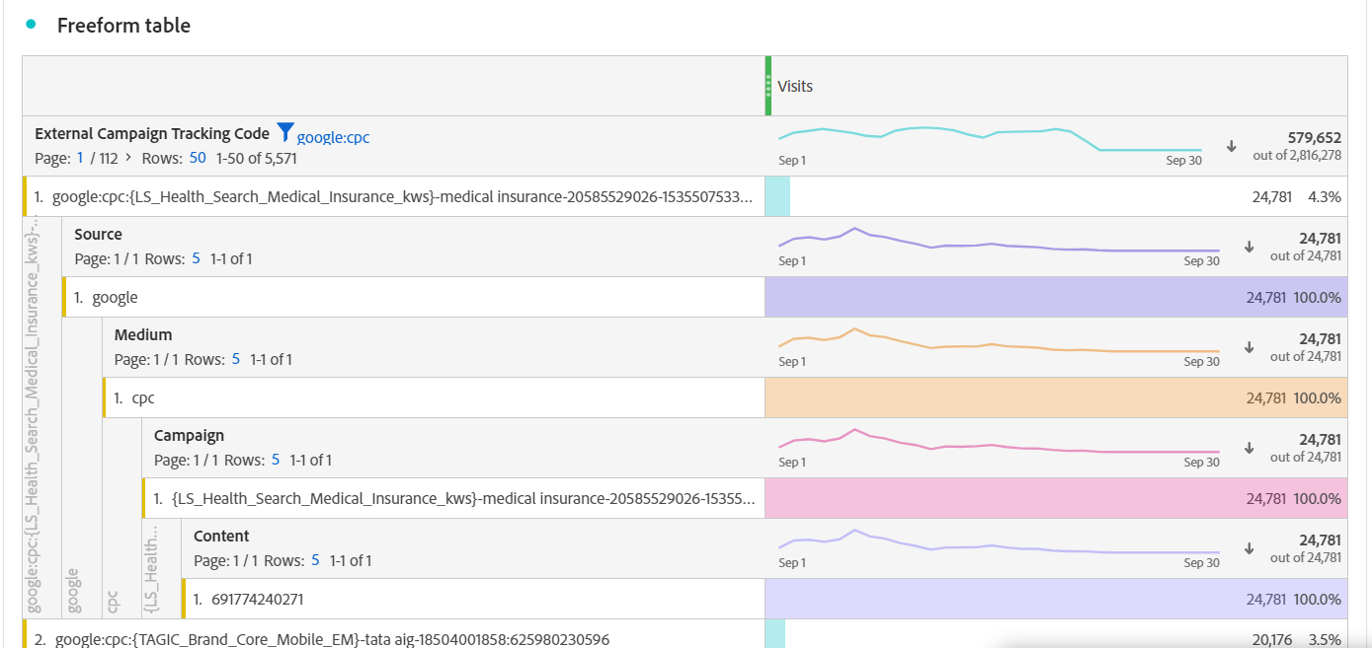
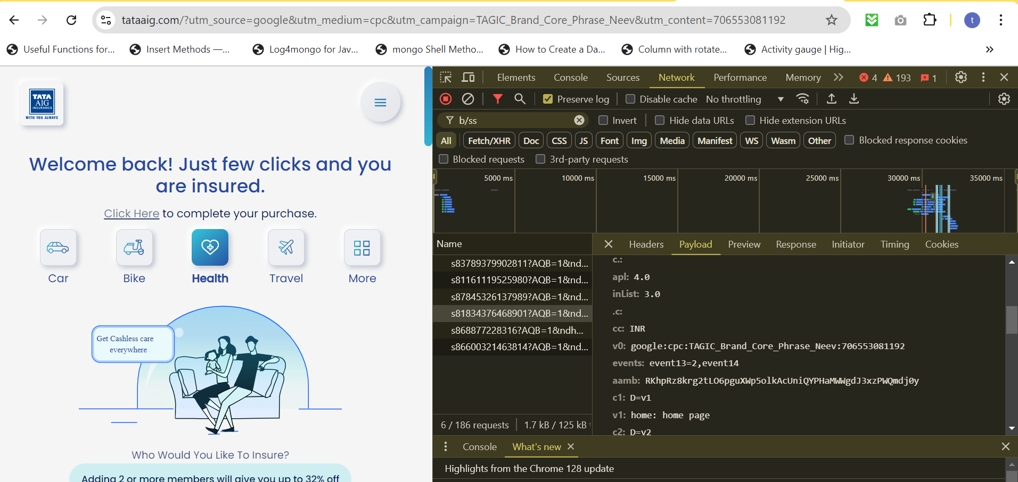
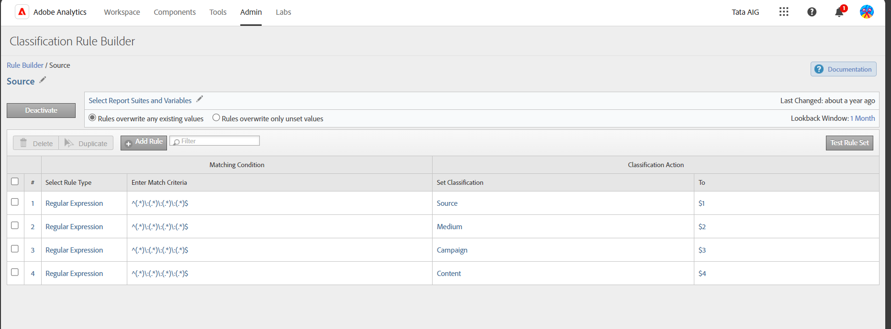
https://www.tataaig.com/?utm_source=google&utm_medium=cpc&utm_campaign=TAGIC_Brand_Core_Phrase_Neev&utm_content=706553081192
Source:medium:campaign:content

Slide 39
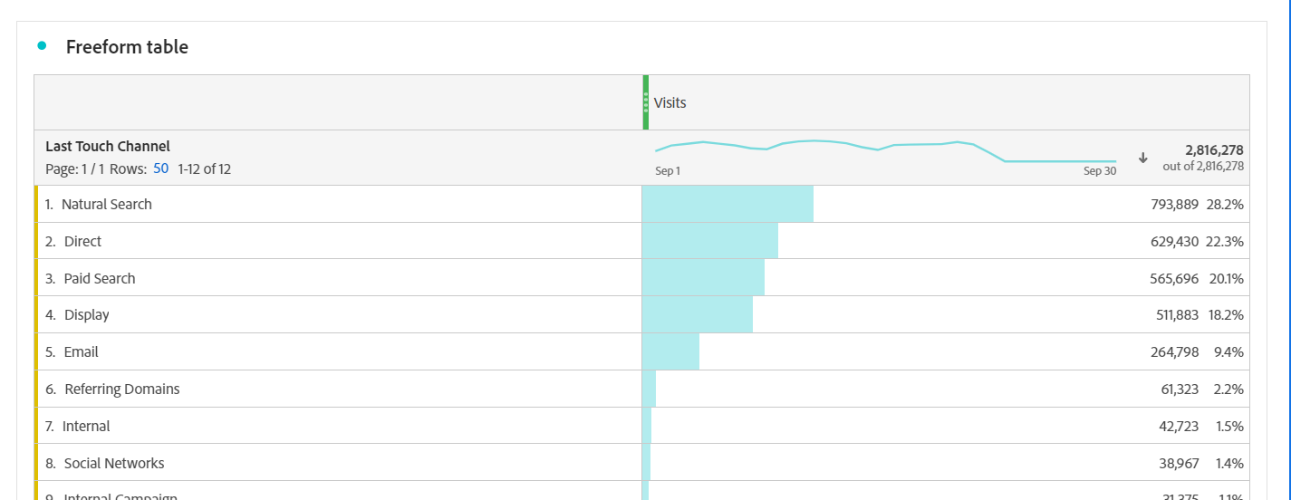
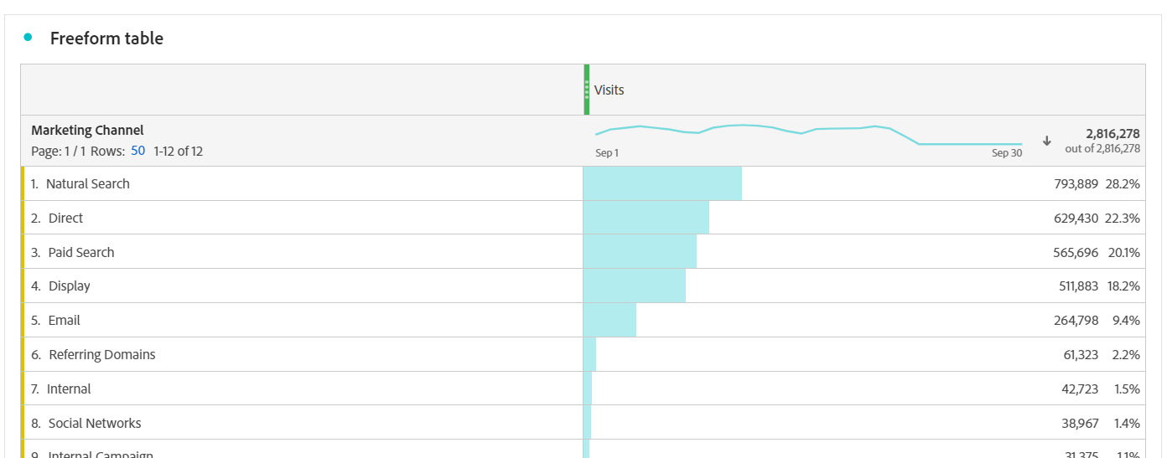
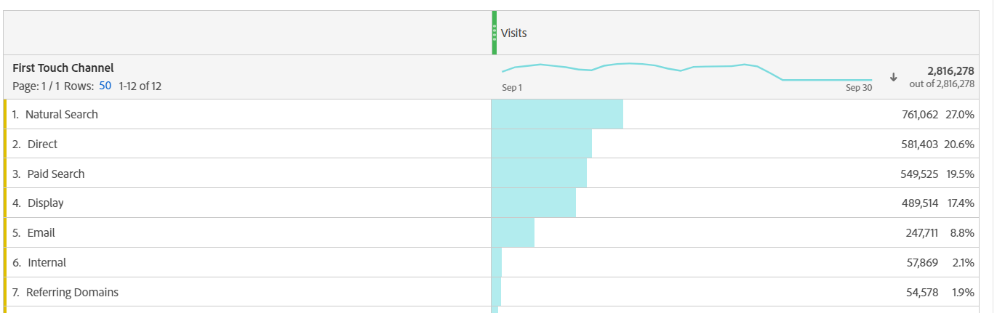
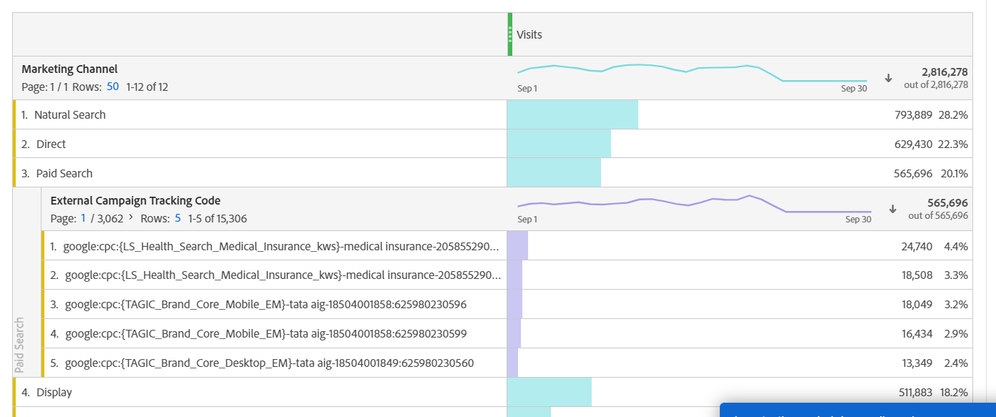
Channel groupings based on external campaign tracking code and channel flow

Slide 40
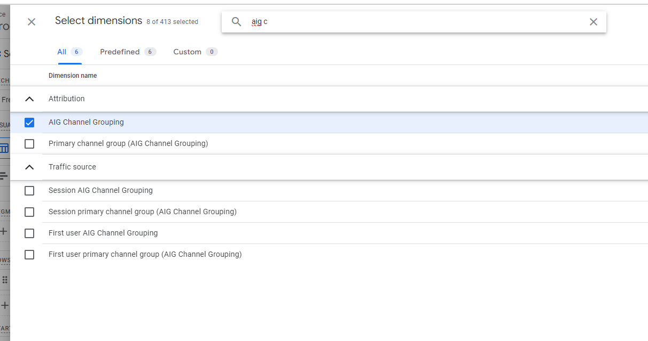
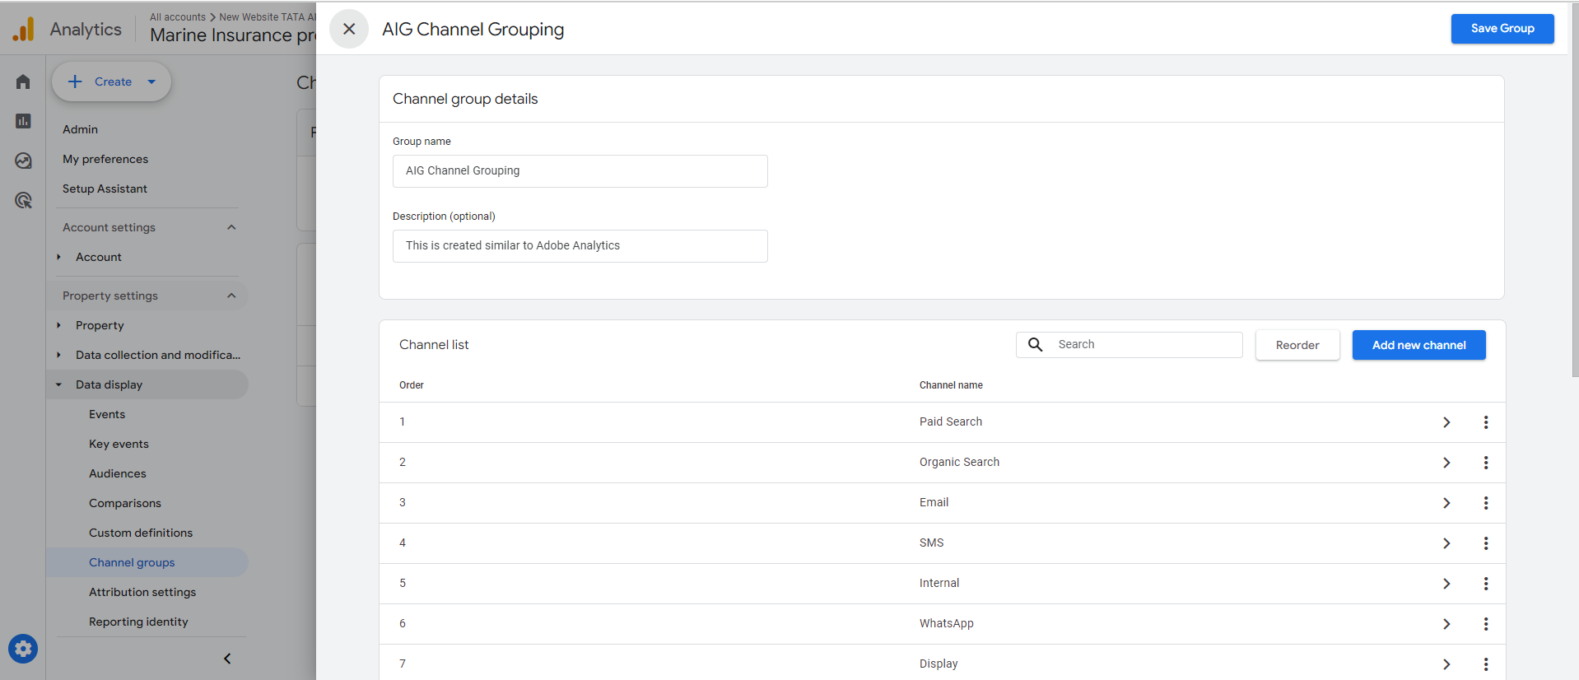
Types of channel Grouping in GA4:
Event based
Session based
user based
Created at admin section as AIG channel Grouping

Slide 41
Date – 13/03/24
Date – 14/06/24
display
paid
natural
paid
natural
Actual path
User journey
display
display
display
display
display
user based
Session based
display
display
display
paid
paid
display
paid
paid
Event based
display
display
paid
natural
paid
natural

Slide 42
Dashboards
MOP → https://analytics.google.com/analytics/web/#/analysis/p396010147/edit/LaIAboIPSp6ypfMOzlqQSQ
Marine → https://analytics.google.com/analytics/web/#/analysis/p396010147/edit/vpMgXXz4S5C77j5Ec9jOpA
GHI → https://analytics.google.com/analytics/web/#/analysis/p406912634/edit/zEwDxEShSHG0xnpfexmXYA
FnB →
https://analytics.google.com/analytics/web/#/analysis/p409210302/edit/78GD9aB-TfanYWBVXWGuLQ

Slide 43
Google looker

Slide 44
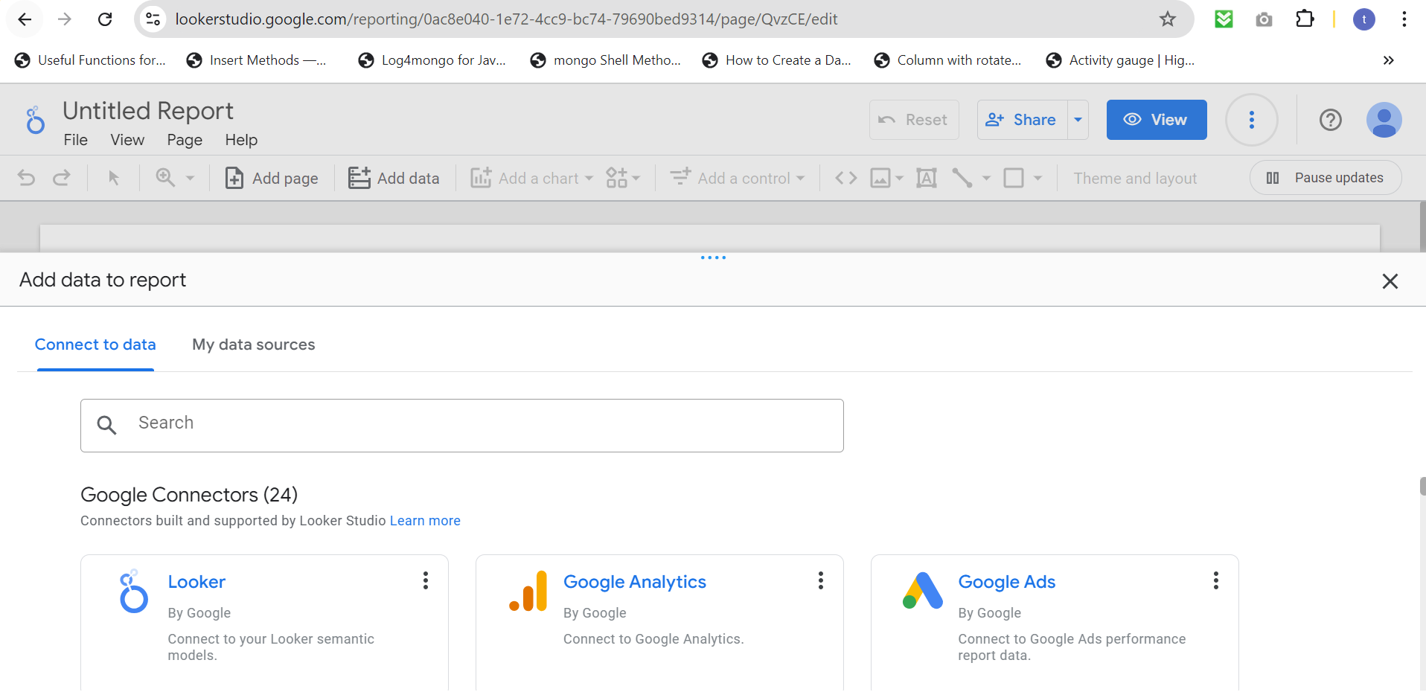

Step1) - Forming the new connection between looker and GA4

Slide 45


Step2) – Create new page containing:
Dimension : Day
Metric : unique quotes, Transaction
unique quotes formula

Slide 46


Step3) – Create new page containing:
Dimension : Day
Metric : unique quotes, unique proposal, unique payment, unique Thankyou
Condition for:
Unique quotes:
Metric : unique quotes
Dimension : day
Event name contains Buy-Quote
Unique Proposal:
Metric : unique quotes
Dimension : day
Event name contains Buy-Proposal

